Slide 1
Once Upon a Time…
There were notes about FAIRY TALES

Slide 2
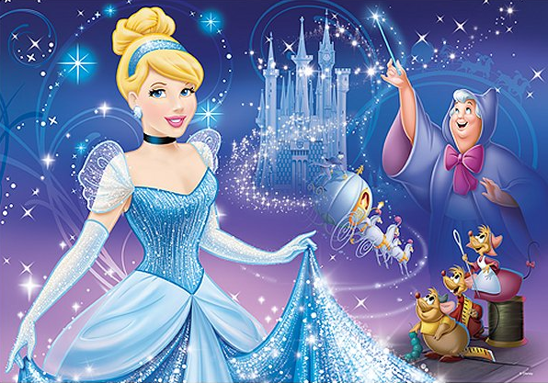
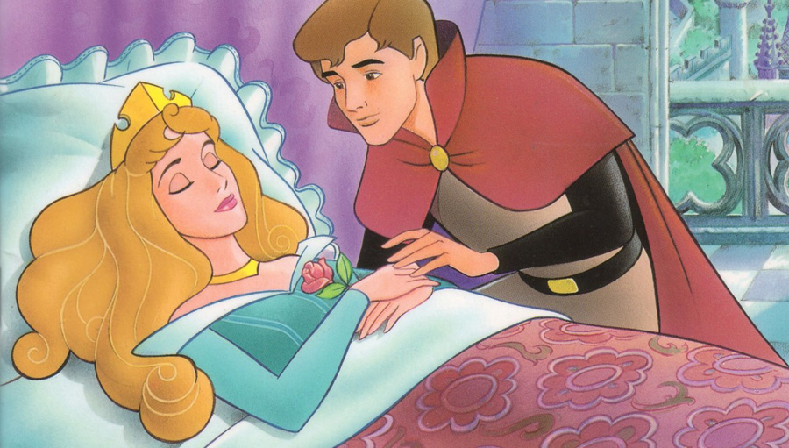
What are Fairy Tales?
They are fictional stories that feature folkloric characters and enchantments, often involving a far-fetched sequence of events.

Slide 3
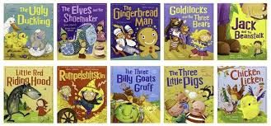
Fairy Tales for Beginners
Plots—are short, simple, and direct.
Action—concentrated and fast paced, adding interest.
Characters—are two-dimensional and easily identified as good/bad.
Settings—are unimportant and vague.
Themes—are limited.
Endings—are almost always happy.

Slide 4
The Plot Structure
Uses direct plots…
Exposition
Rising Action
Climax
Falling Action
Resolution

Slide 5
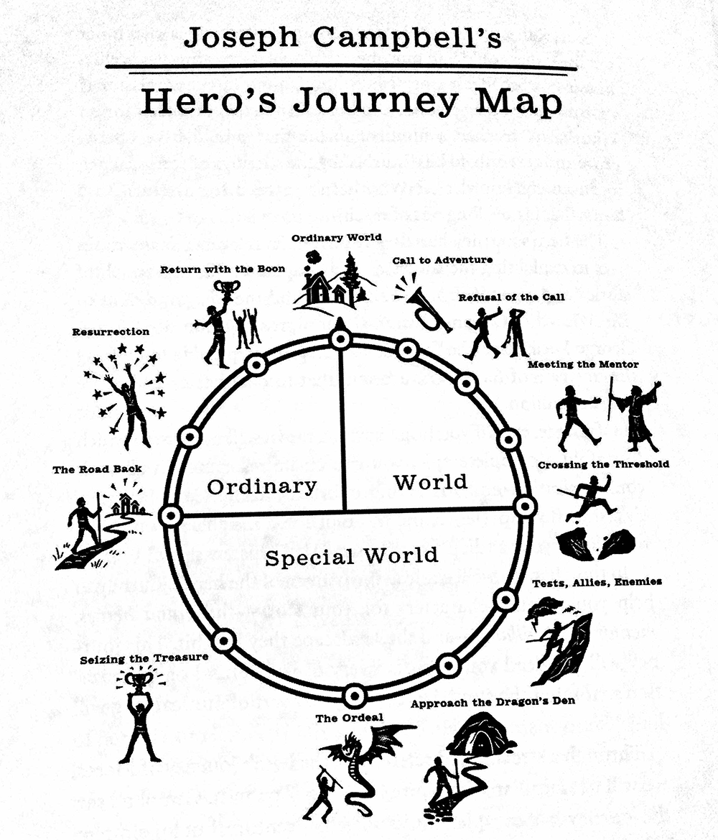
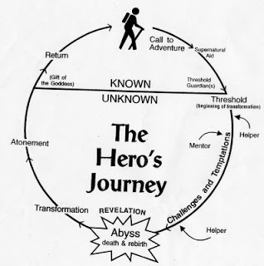

Slide 6
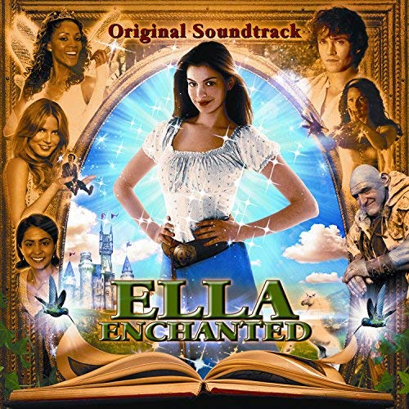
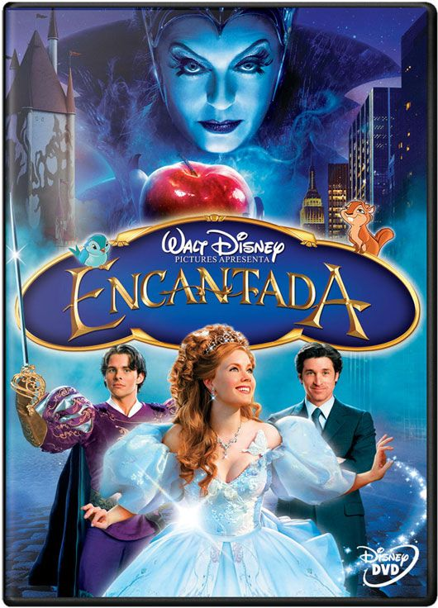
Characteristics of Fairy Tales
Special beginning and/or ending phrases.
“Once upon a time…”
“…And they lived happily ever after.”
Good characters.
Evil characters.
Moral of the story is ????

Slide 7
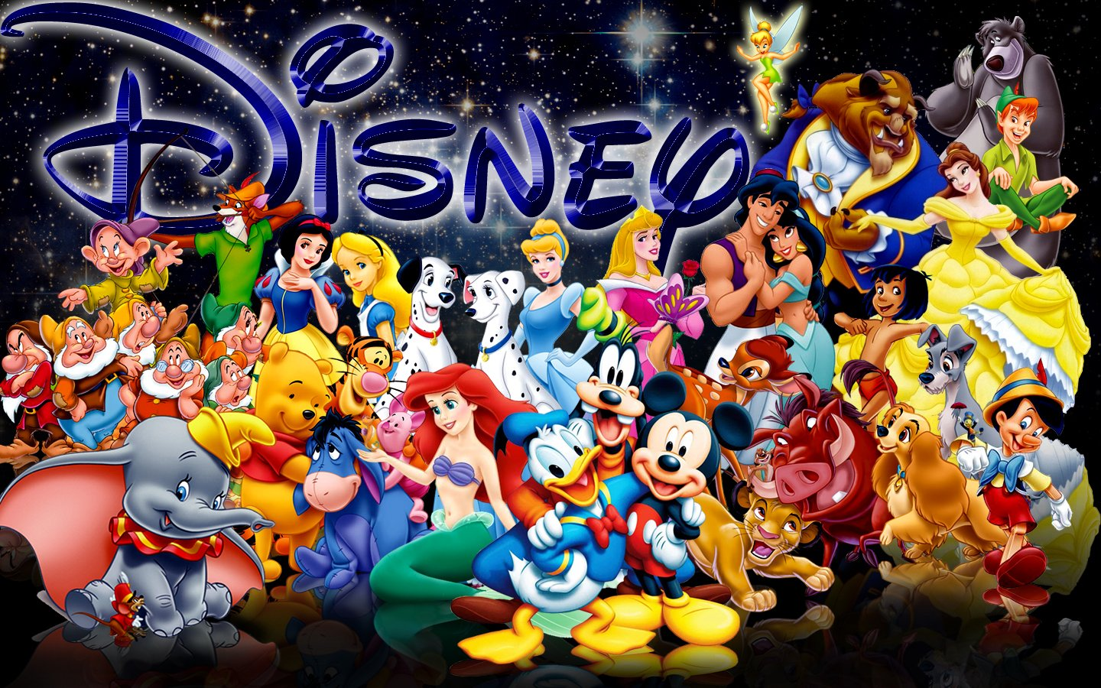
Characteristics of Fairy Tales
Royalty
Poverty
Magic &
Enchantment
Reoccurring Patterns
Universal Truths

Slide 8
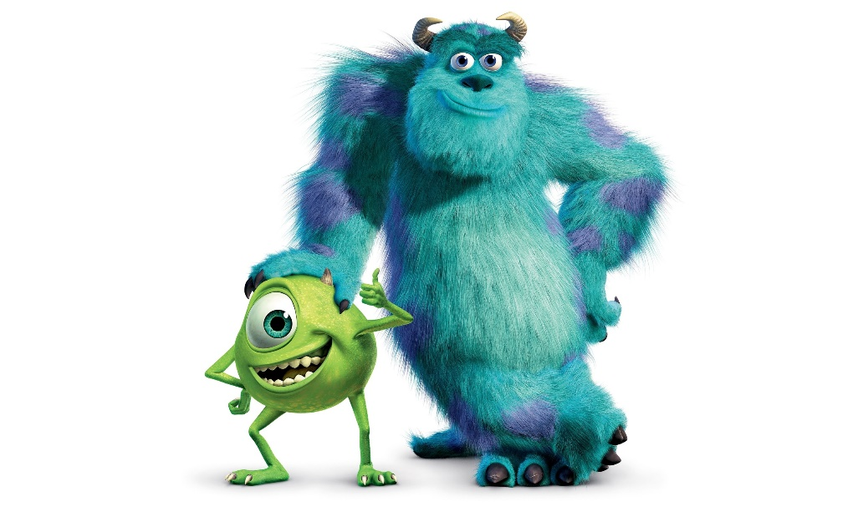
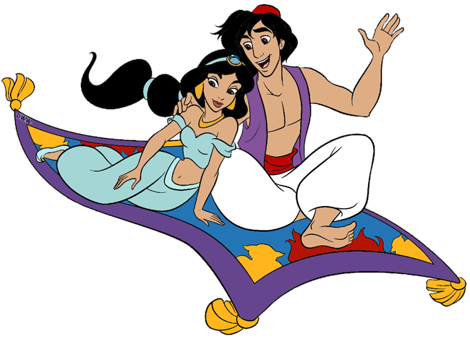
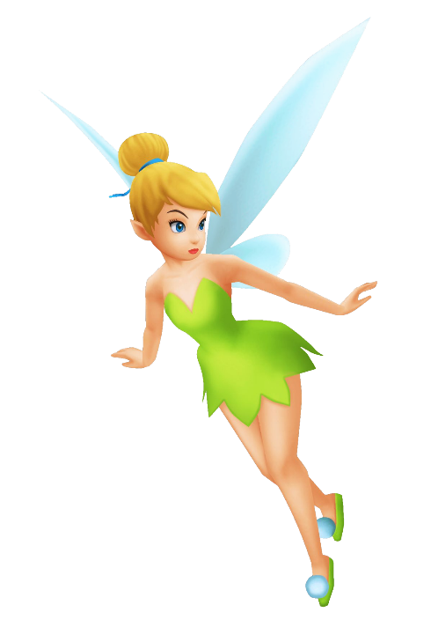
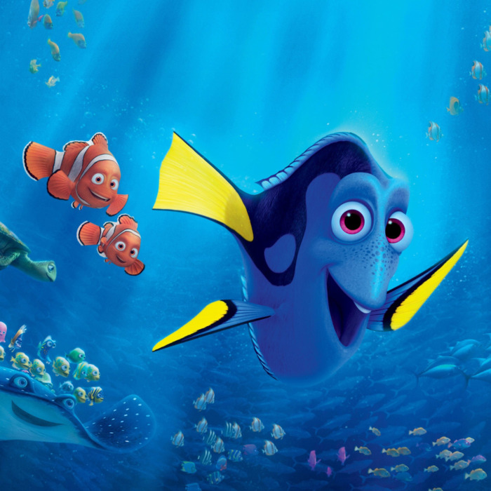
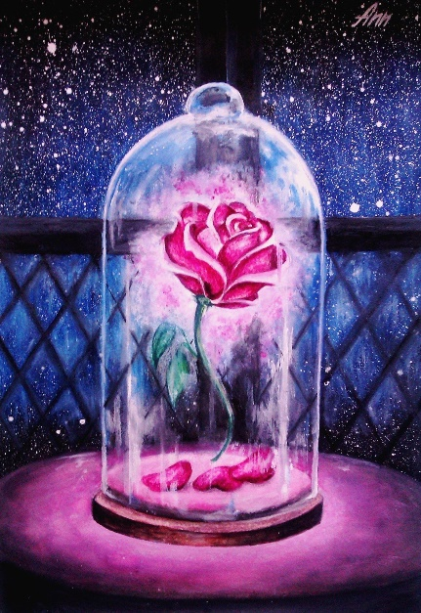
Motifs
Talking Animals
Cleverness / Trickster
Traveler’s tales / Quests
Triumph of the poor
Human weakness / strengths
Magic words / phrases
Guardians/ Monsters / Helpers
Impossible Tasks

Slide 9
Ways Fairy Tales are Interpreted
Jungian Archetypes
Man’s collective subconscious, collective dream, shared experiences, deepest desires/fears.
Freudian Psychoanalysis
The id, the ego, the superego are always warring—our primal needs are always at odds with our consciences.
Feminist Theory
Aims to understand the nature of inequality.
Focuses on gender politics—power relations.

Slide 10
Ways Fairy Tales are Interpreted
Morphology
Analyzes the function of each character / action.
Each sotry is composed of 31 elements and 8 character types.
Historic Analysis
Seeing tales as a way to preserve history, legend, customs.
Moral Lesson
All of Charles Perrault’s versions end with a lesson / moral

