Slide 1
Yields and Dividends
Q: How many years do you plan to work between the age of 18 and 65?
A: probably around 30 years

Slide 2
Determining lifetime earnings
$20,000 x _____ years in workforce= ___________
$30,000 x _____ years in workforce= ___________
$50,000 x _____ years in workforce= ___________
$75,000 x _____ years in workforce= ___________
$100,000 x ____ years in workforce= ___________

Slide 3
Lifetime Earnings
● $20,000 x 30 years in workforce= $600,000
● $30,000 x 30 years in workforce= $900,000
● $50,000 x 30 years in workforce= $1,500,000
● $75,000 x 30 years in workforce= $2,250,000
● $100,000 x 30 years in workforce= $3,000,000

Slide 4
Food for Thought……
What is the difference between a $20,000 and $30,000 salary? ($10,000)
What is the difference between a $20,000 and $50,000? ($30,000)
What is the difference between $20,000 and $75,000? ($55,000)
What is the difference between $20,000 and $100,000? ($80,000)

Slide 5
Minimum Wage in California
$10.50 an hour (2017)
40 hours a week
50 weeks in a year (standard 2 weeks vacation)
$10.50 x 40 x 50=_________
Total: $21,000.00
Can you survive off of $21,000 annually ?????

Slide 6
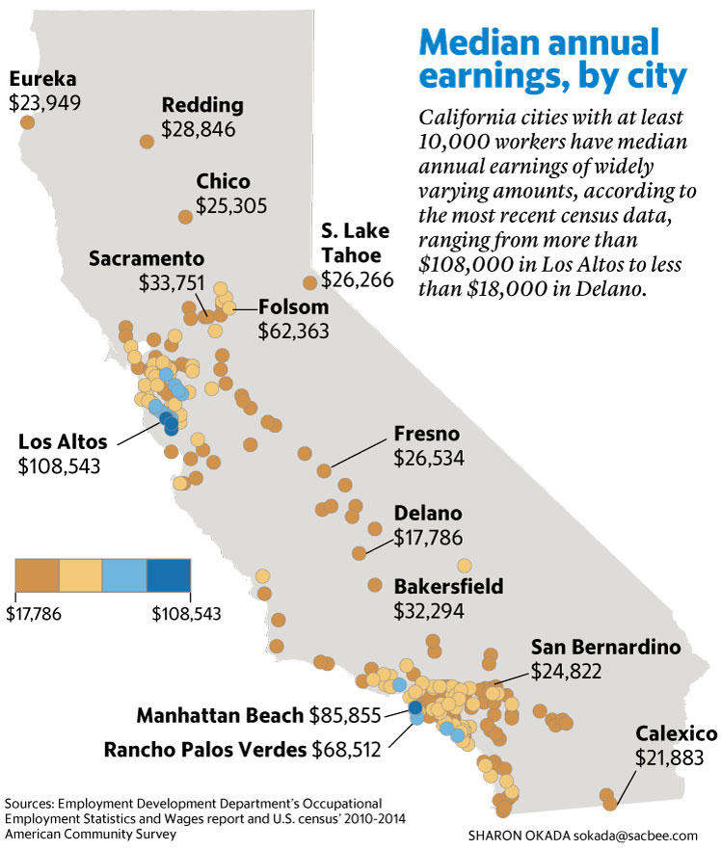

Slide 7
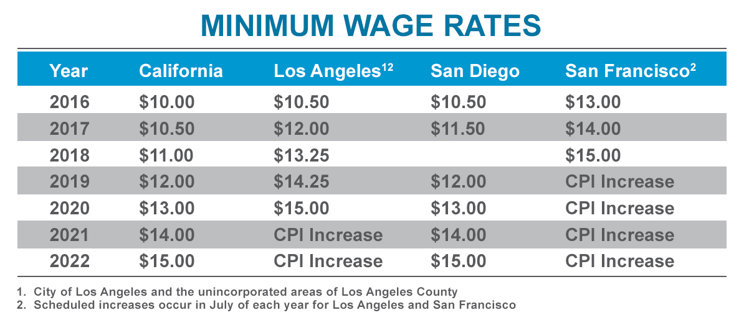

Slide 8
