Slide 1
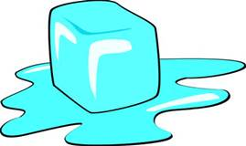
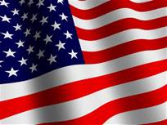
The Cold War Thaws

Slide 2
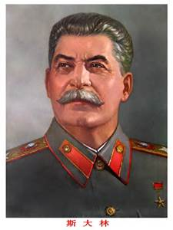
Soviet Union
Joseph Stalin Died on March 5, 1953
Nikita Khrushchev took over after Stalin
Khrushchev announced the policy of destalinization
The point was to point the Soviet Union in a new direction
Wanted to make sure people forgot about Stalin
Monuments were destroyed and his body was moved outside the Kremlin wall

Slide 3
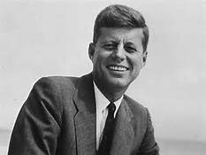
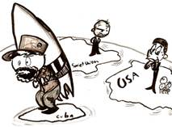
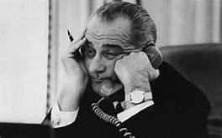
United States
John F. Kennedy involved in a U-2 plane incident and Cuban Missile Crisis, put the US on the brink of war
After the assassination of Kennedy, Lyndon Johnson becomes president
Johnson believed in containment and domino theory.
Which escalated the US involvement in Vietnam.
Protest and government deceiving the people lead to a withdrawal
Johnson didn’t run for re-election

Slide 4
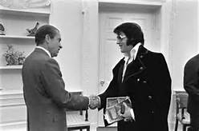
Richard Nixon
Richard Nixon became president in 1969
Ran on the promise that he would deescalate the war in Vietnam
He actually expanded the war into Cambodia
Nixon wanted to drastically change US policy on dealing with the Soviet Union
Introduced Détente to lessen the tension
This policy came from realpolitik which means “realistic politics”
-Practical and based on circumstances rather than ideological/moral beliefs

Slide 5
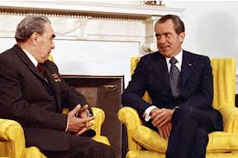
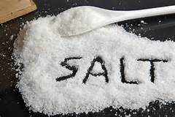
United States reduces tensions
Both the US and Soviet Union agreed to reduce tensions
In February 1972, Nixon became the 1st president to visit the Soviet Union
Nixon and Brezhnev had a series of meeting called Strategic Arms Limitation Talks (SALT)
This limited the number of ballistic and submarine-launched missiles each country can have

Slide 6
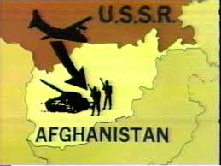
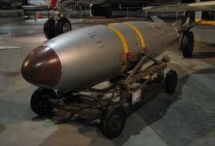
Détente cools
Nixon and Ford tried to improve relations with the Détente policy
Jimmy Carter and the Soviet Union didn’t get along
Carter and Brezhnev signed SALT II in June 1979
US congress never ratified the agreement because of the Soviet Union involvement in Afghanistan
This caused nations around the world to build up their nuclear weapons

Slide 7
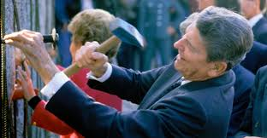
Ronald Reagan
Reagan took office after Jimmy Carter in 1981
He was against the policy of détente
Reagan announced a program called Strategic Defense Initiative (SDI)
The program also had another name that was named after a famous movie Star Wars
This program was to help protect America from enemy missiles
This helped lead to the end of the Cold War

