Slide 1
WWII Ends
An Allied Victory
Unit 7

Slide 2
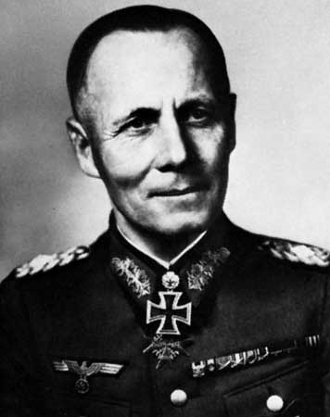
The Tide Turns
Key battles helped the Allies gain the advantage in Africa & the Eastern Front:
  The Battle of El Alamein: Egypt, 1942
    Rommel vs. Gen. Montgomery
  Operation Torch: Northern Africa,
    1942-43
    Rommel vs. Gen. Eisenhower
  Battle of Stalingrad: German army
  on the defensive, 1942-43
  Invasion of Italy: Italy surrendered, Mussolini murdered (April 1945)

Slide 3
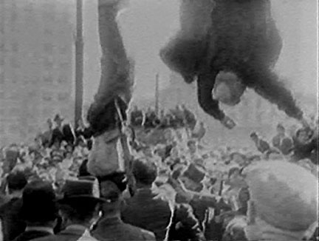
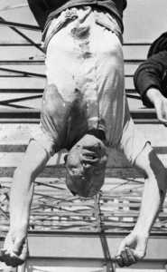
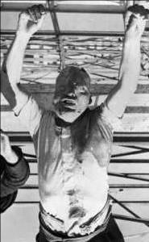
Mussolini Hanging in Milan, Italy

Slide 4
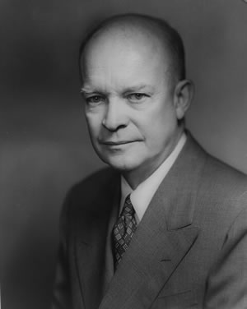
Victory in Europe
1943, a secret invasion force was built in Great Britain
D-Day invasion force was ready for
  Normandy, France
  Called Operation Overlord
  Lead by U.S. Gen. Eisenhower
  Largest land/sea attack in history
  Began June 6, 1944
Germany knew of invasion, but where?
  Fake army sent to Calais, France, Germany duped
France, Belgium & Luxembourg liberated Sept. 1944

Slide 5
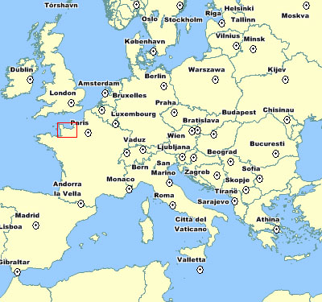
D-Day Invasion

Slide 6
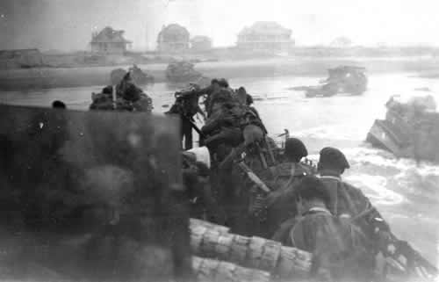
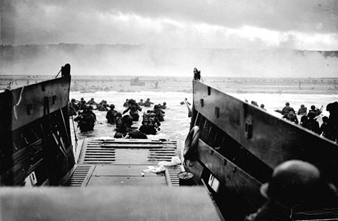
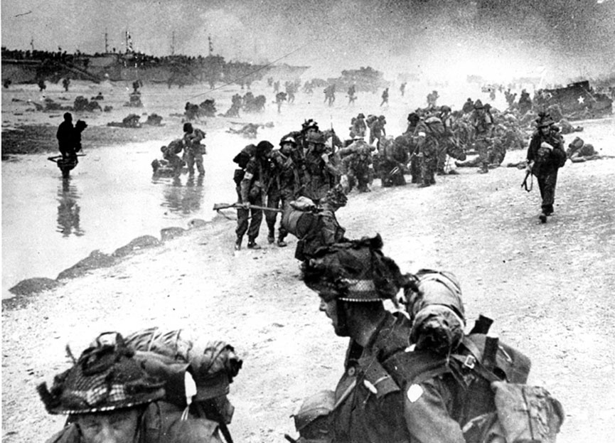
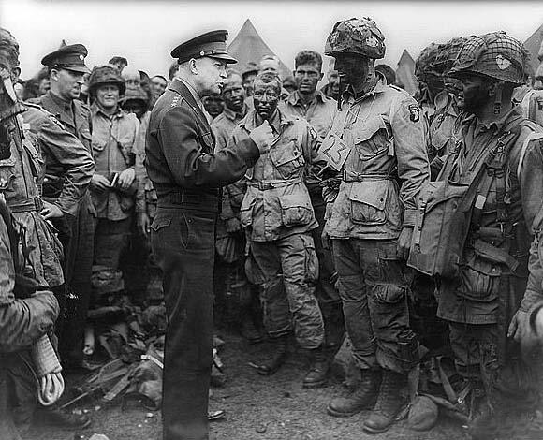
D-Day Invasion Images

Slide 7
The End is Near
Battle of the Bulge:
  Germany surrounded by Britain/America in West and Soviet Union in East
    2 front battle
  Hitler pushed through the line, but the Allies pushed him back
By March 1945, the Allies crossed into Germany, Berlin bombed
Hitler committed suicide, April 30, 1945

Slide 8
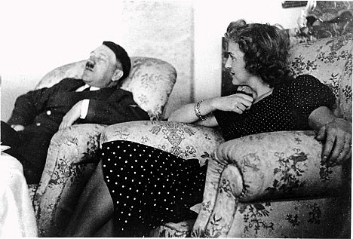
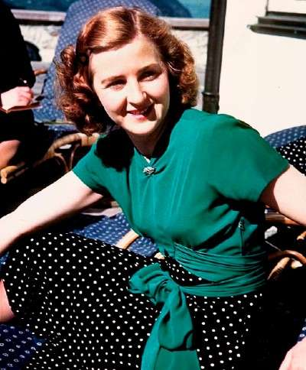
Hitler and Eva Braun

Slide 9
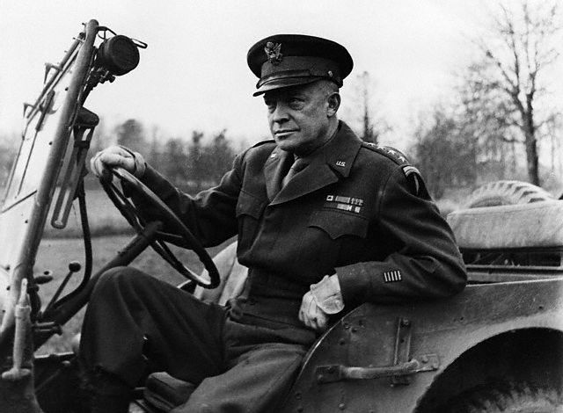
Unconditional Surrender
Germany surrendered on May 7, 1945
  Accepted by General Eisenhower
May 9th, surrender was officially signed
  Known as V-E Day, Victory in Europe Day

Slide 10
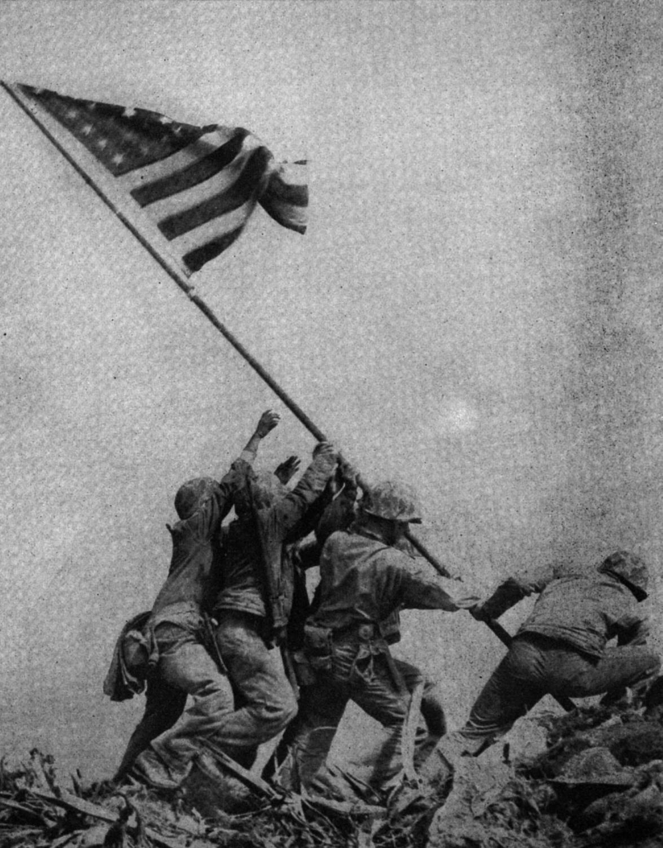
Victory in the Pacific
Although the war had ended in Europe, fighting would continue in the Pacific.
The Japanese lost ground as the Allies closed in.
  Battle of Leyte
  Iwo Jima (March 1945)
  Okinawa- (April-June 1945-bloodiest land battle of the war)

Slide 11
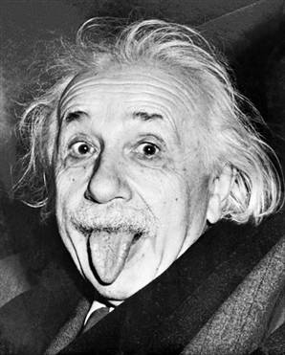
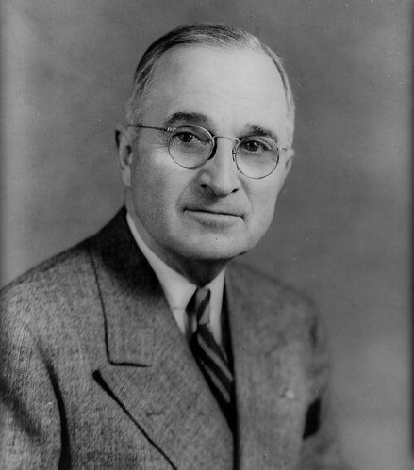
The Atomic Bomb
Pres. Roosevelt died in April 1945, VP Truman became president.
Pres. Truman was informed that an invasion of Japan could cost ½ million Allied lives.
Truman had to decide whether or not to use a brand new weapon to end the war- the atomic bomb
  Known as the Manhattan Project
  Truman only knew about it when he became president.
  Truman gave Japan a surrender warning- no response from Japan.

Slide 12
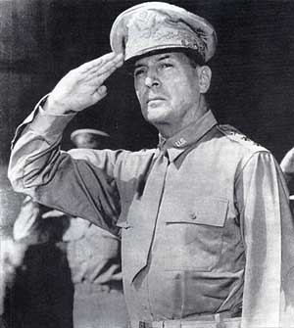
The War is Over
First bomb dropped Aug. 6, 1945 on Hiroshima
  73,000 killed instantly
  No surrender response from Japan
Second bomb dropped Aug. 9, 1945 on Nagasaki
  37,000 killed instantly
  Radiation killed many more
Japanese surrendered to U.S. Gen. MacArthur on Sept. 2, 1945: V-J Day, Victory in Japan Day!

Slide 13
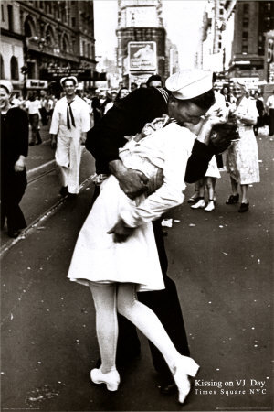
Victory in Japan Day!

Slide 14
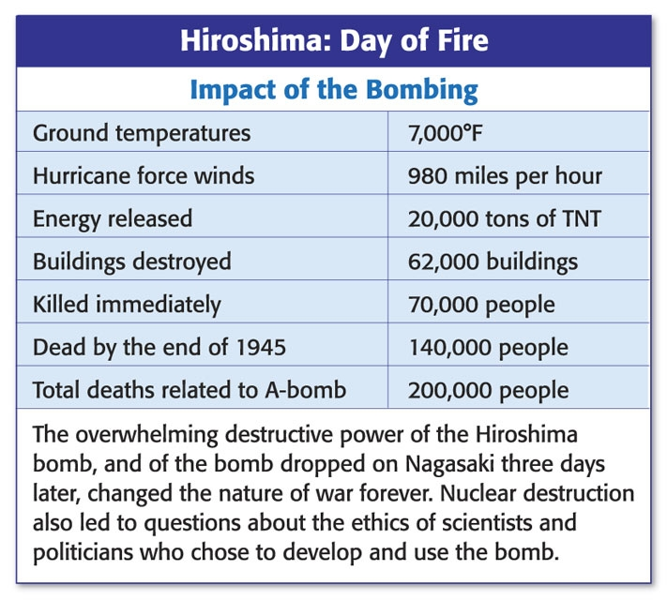
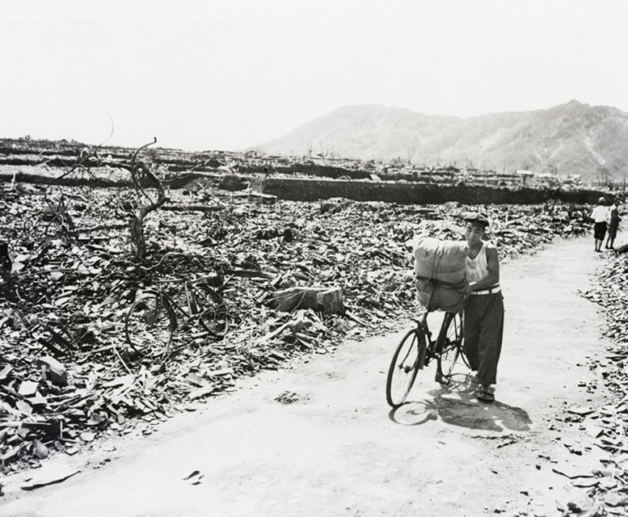
Bombing Aftermath

Slide 15
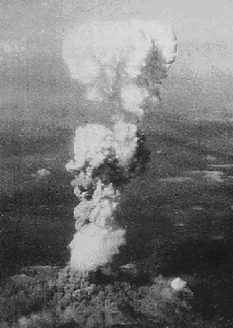
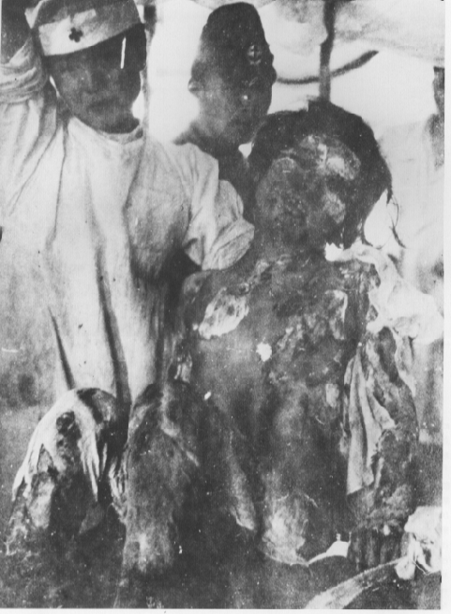
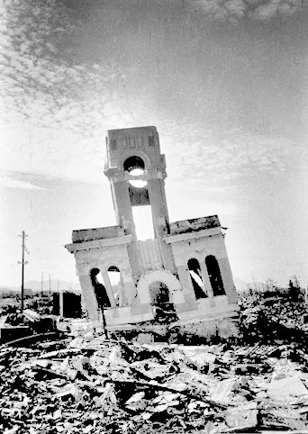
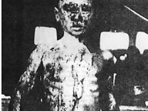
Hiroshima Pictures

Slide 16
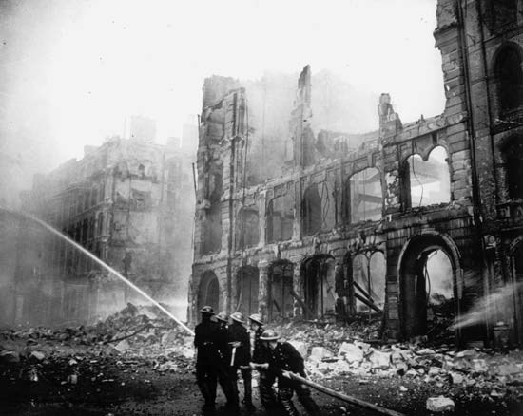
Aftermath of War
60 million people dead (S.U. had the most)
50 million uprooted from homes
Property damage was in the billions (major cities destroyed)
Many searched for lost family members.
Communists rise up in war-torn countries
United Nations formed in June 1945 to prevent future aggressions

Slide 17
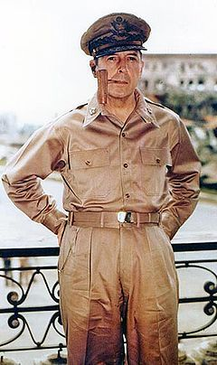
U.S. Occupies Japan
General MacArthur- began process of demilitarization in Japan
Goal- bring democracy to the people
  New constitution signed May 3, 1947
  2 billion dollars in U.S. aid
  Emperor had to declare “he was not a God.”

Slide 18
Nuremburg Trials
In 1946, 23 nations attempted to punish high ranking German officials for their role in the Holocaust
  22 Nazi leaders were put on trial in what became known as the Nuremburg Trials
  Tried for war “crimes against humanity”
  12 of the 22 on trial were sentenced to death by hanging
  Only 1 of those convicted expressed remorse
  2 committed suicide before they were hanged
  After the hangings, the bodies were burned at the Dachau concentration camp in the same ovens that cremated the Jews

Slide 19
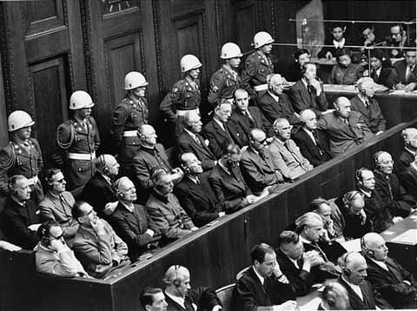
Nuremburg Defendants

