Slide 1
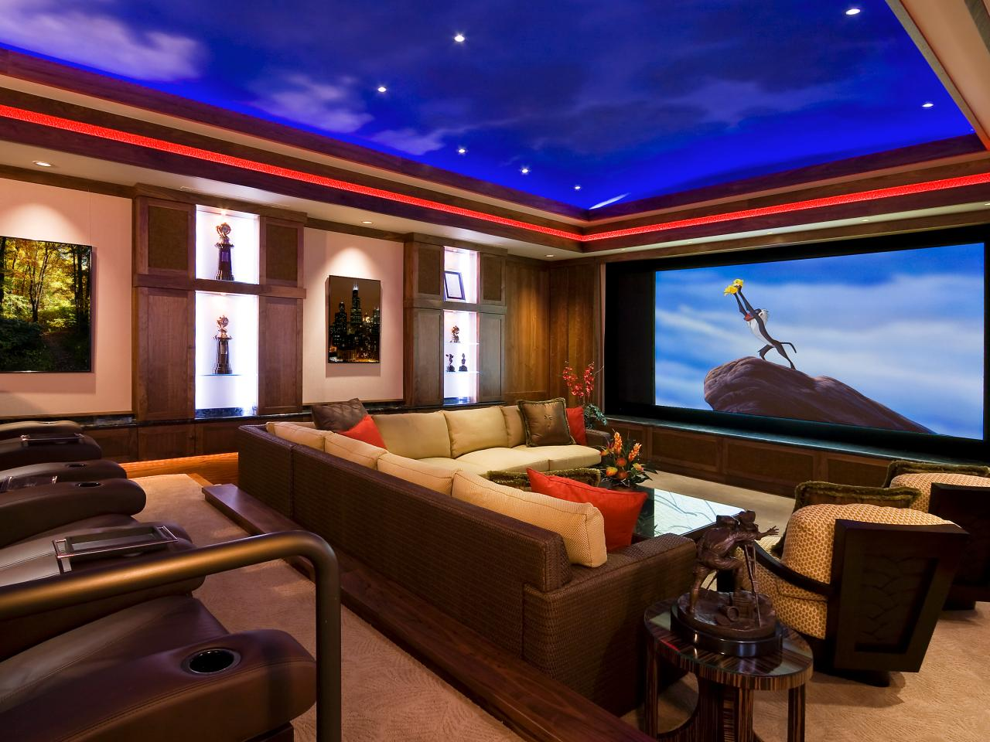
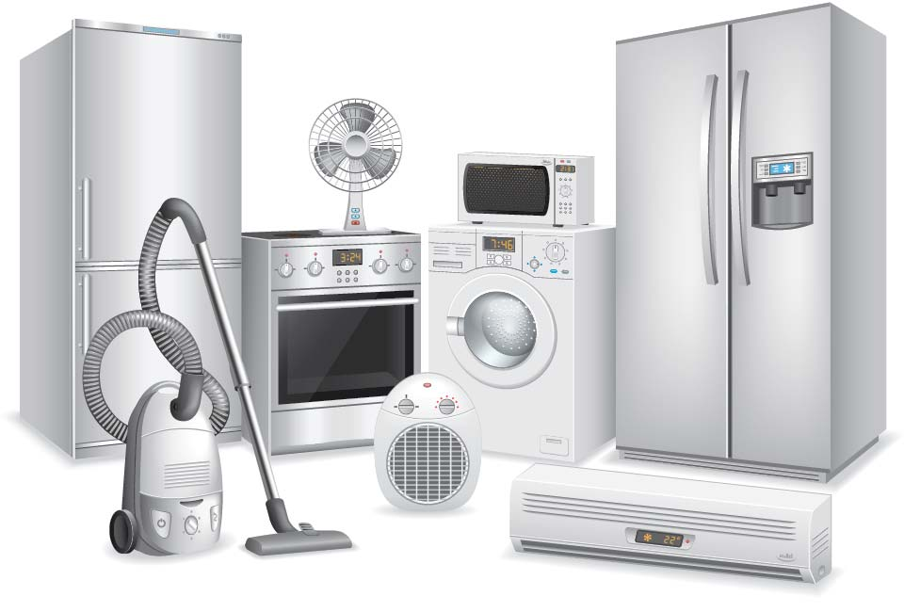
FURNISHINGS/APPLIANCES

Slide 2
Furnishings/Appliances
Most people have a few very large financial expenses at certain times in their lives. They may want to send a child to college, buy a new house, replace a major appliance, or the like.
For these types of expenses a long-term budget can be helpful.

Slide 3
Long-term Budget
A plan for setting aside enough money to pay a large expense at some time in the future.

Slide 4
Long-Term Budget for Furnishings
We want to save enough money to pay cash when our major appliance wear out. The age of our present appliance is given. In order to determine when we will need to replace them we need to know the average lifetime and average price.

Slide 5
ITEM | AGE | Expected Lifetime | Expected Cost | Monthly Budget
Washing Machine | 8 | 11 | $500- $2000
Television | 3 | 11 | $300- $3000
Vacuum | 5 | 15 | $50- $1000
Refrigerator | 10 | 16 | $800- $2500

