Slide 1
North Africa: Libya
Unit 4

Slide 2
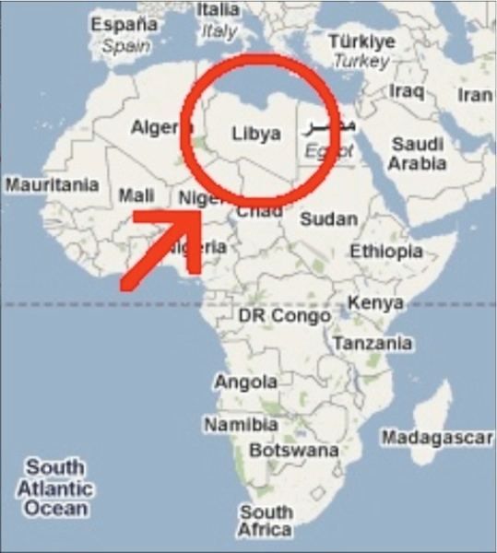

Slide 3
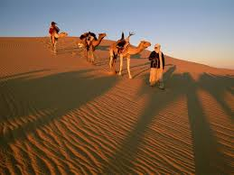
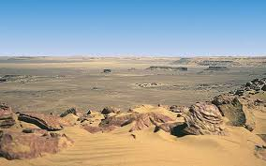
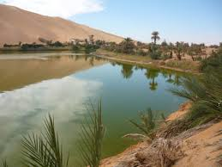
Climate / Terrain
Terrain is mostly barren and flat plains
Much of the country lies within the Sahara Desert
Libya’s climate is dominated by the hot arid Sahara, but its moderated by the Mediterranean Sea on the coast line

Slide 4
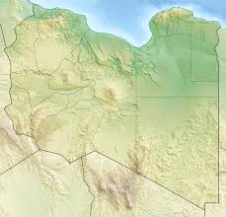
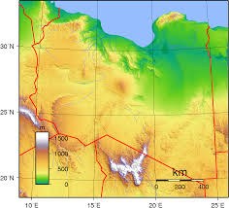

Slide 5
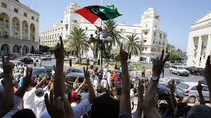
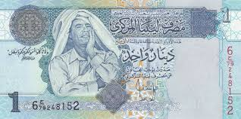
Government / Economy
Government: Military Dictatorship
A form of government in which a member of the military holds control.
Head of State /Government: Prime Minister
Natural resources: petroleum, natural gas, gypsum
Currency: Libyan Dinar
1 USD = 1.38 Libyan Dinar

Slide 6
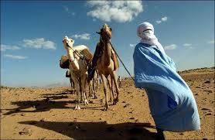
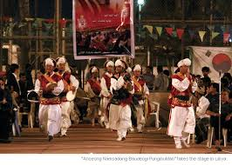
Demography / Culture
Population: 6,244,174
Life expectancy: 76.04
Languages: Arabic
Ethnicity: Berber and Arab 97%
Religion Muslim 96.6%
Literacy rate: 89.5%
Libya provides all its citizens with free education.

Slide 7
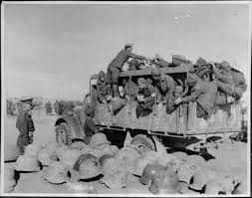
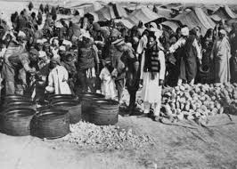
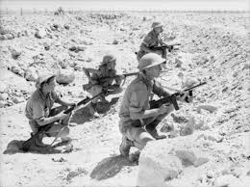
Brief History
Part of the Ottoman Empire in 1551
Italy took control of Libya in 1911, after invading the country and defeating the Turks
British military ruled Libya after the Italians and Germans were defeated in WWII
After WWII, Libya became the first country to gain independence through the United Nations
The Independent Kingdom of Libya was created in Dec 1951, and joined the UN in 1955

Slide 8
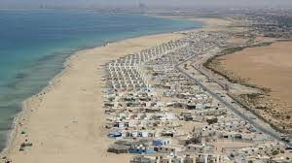
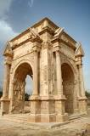
Tourism
Tripoli
Leptis Magna
Benghazi

Slide 9
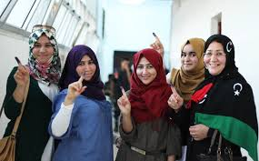
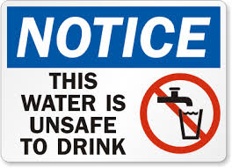
Interesting Facts
Women in the country have absolutely no rights.
Their only roles is to clean, cook and have children
Libyan citizens are given loans at a zero percent interest rate.
There are no beggars on Libyan streets and until recent bombings, there were no homeless either.
The government provides free houses or apartments to all newly-married couples.
Almost one third of the Libyan population does not have access to any safe drinking water.

Slide 10
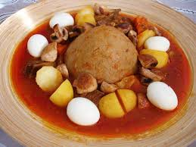
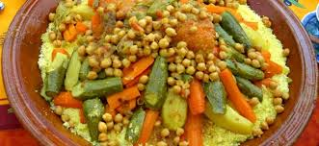
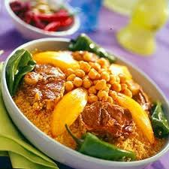
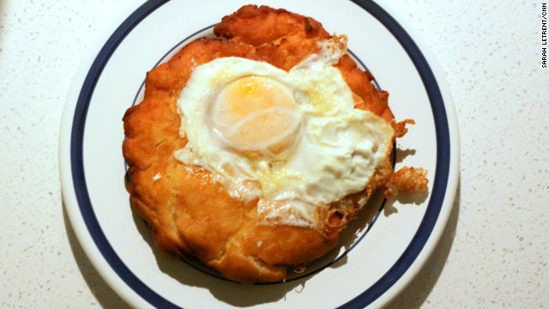
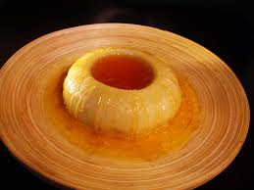
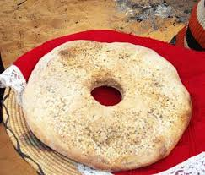
Food

