Slide 1
PANAMA
A Path Between the Seas

Slide 2
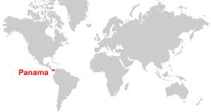

Slide 3
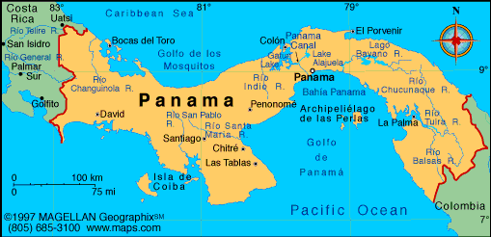

Slide 4
Climate/Terrain
Panama is a small country located on an isthmus (narrow piece of land connecting two larger pieces) in Central America
Panama has a tropical climate
Temperature ranges between 75ºF-89ºF year round
Away from the coast, the interior is steep and rugged
40% of Panama is covered in tropical rainforest

Slide 5
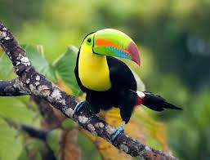
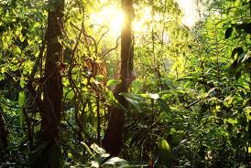
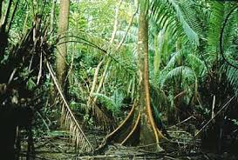
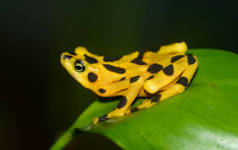
Notes:
Panama Spotted Frog extinct in the wild since 2007. Highly venomous. Loss of Habitat due to deforestation.

Slide 6
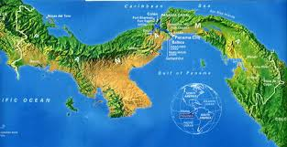
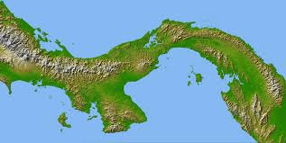

Slide 7
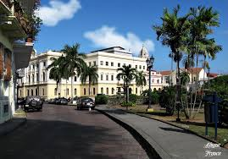
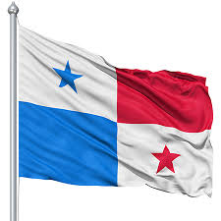
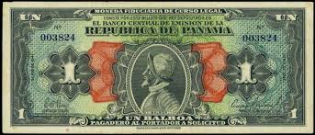
Government/Economy
Capital: Panama City
Government: Constitutional Democracy
Head of Government: President
2nd in command: Vice President
Economy based on Services and Tourism
Currency: The US dollar/ The Panama Balboa
$1 US=1 Balboa
Notes:
Vasco Nunez de Balboa discovered the Pacific in 1513

Slide 8
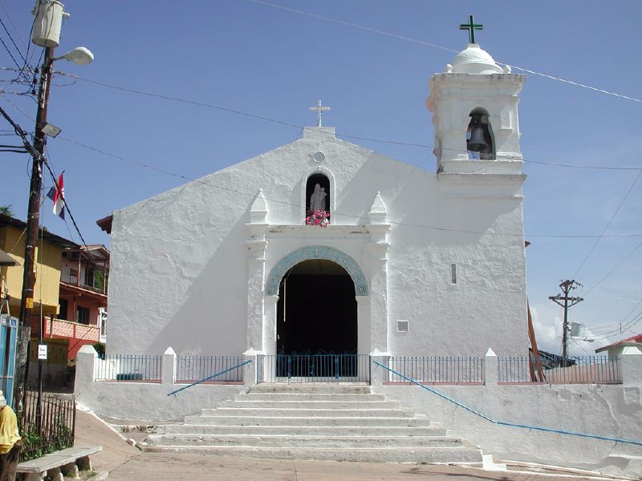
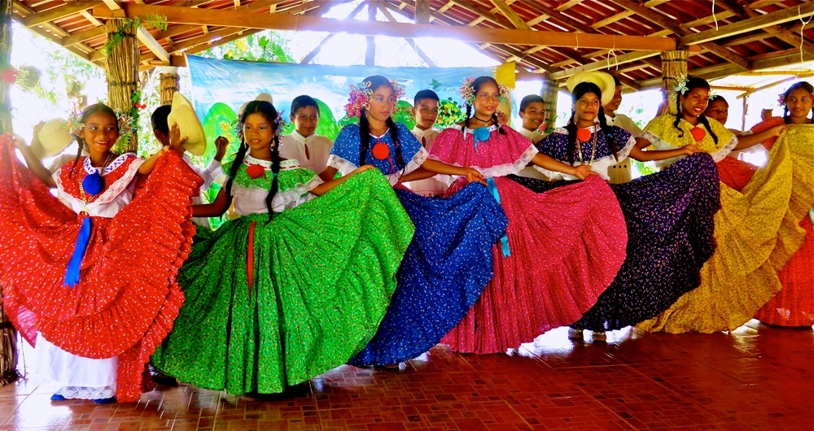
Demography
Population: 3.8+ million
Religion: Roman Catholic
Literacy Rate: 94.1%
Life Expectancy: 74.4 (M), 80.5 (F)
Language: Spanish
Sports: Soccer and Baseball
Cultural: Influence of African,
Native Panamanian, & European

Slide 9
Brief History
In 1513, Spanish explorer Vasco Nuñez de Balboa saw the Pacific Ocean, realized it was an Isthmus
Became a center for Spanish trade
Cimarrons were African Slaves who fled there from Spanish gold mines
1821, Columbia became independent from Spain and Panama was a part of Columbia
First the French and then the US build the Panama Canal (1903-1914)
US helps Panama become independent in 1903

Slide 10
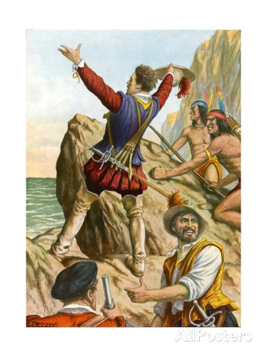
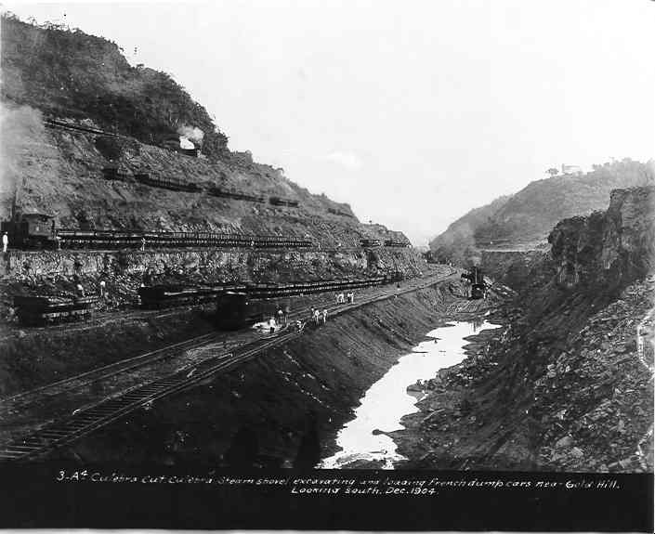
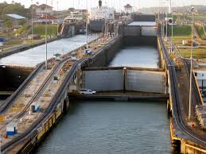
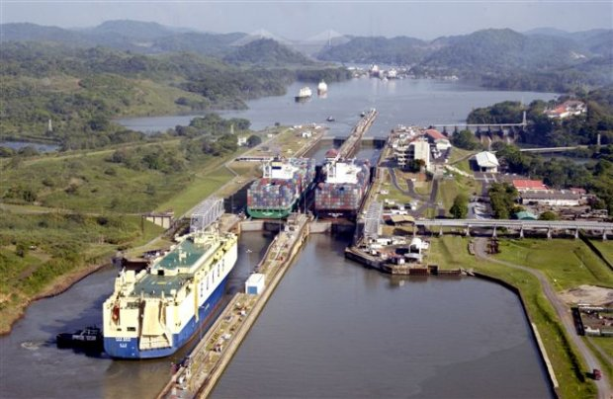

Slide 11
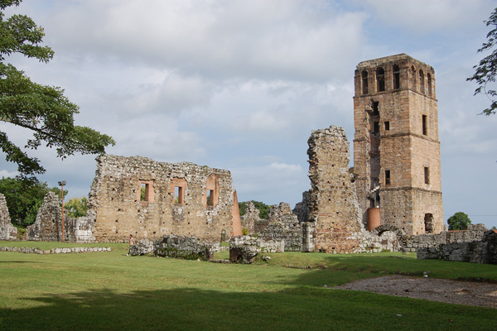
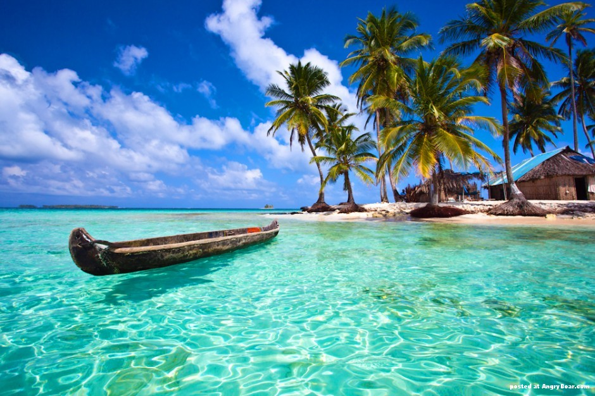
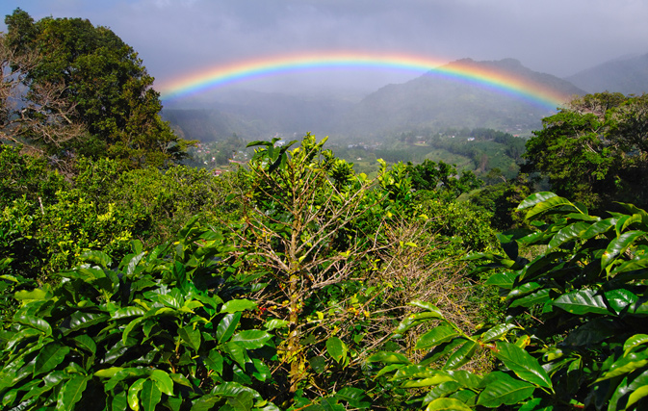
Tourism
Canal Tours
Panama Viejo

Slide 12
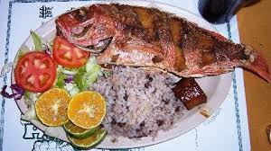
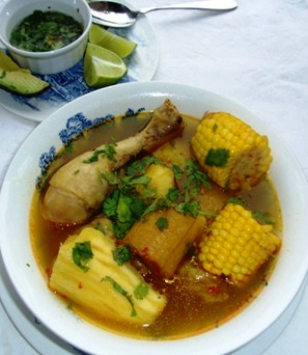
Food
Tortillas
Fish and Rice
Sancocho

