Slide 1
Modified Maslow’s Triangle

Slide 2
Some Elements of a Balanced Lifestyle:
1.Physical Health
2. Work relationship
3. Family/relationships
4. Leisure and recreation
5. Spiritual Life
*Note: we will need to divide Maslow’s Triangle in half to make a balanced life.

Slide 3
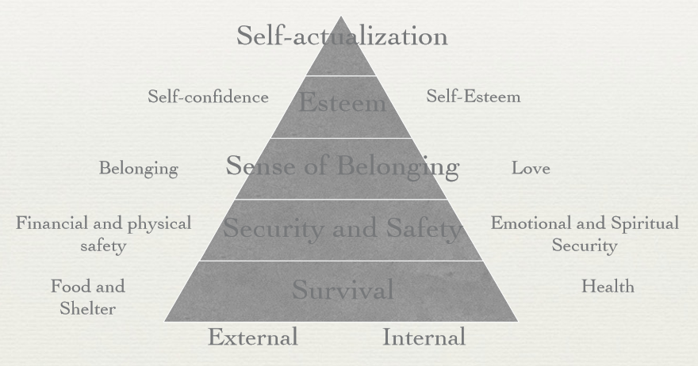
Maslow’s Triangle

Slide 5
External vs Internal Lives
External Lives
1. Career
2. Possessions
3. Education
4. Roles we play
5. The way others see you
Internal Lives
1. Physical well-being
2. Spiritual well-being
3. Values
4. Personal Relationships
5. Health

