Slide 1
The Cold War Intensifies
Aka The Korean War
Unit 8

Slide 2
The Korean War (1950-1953)
Hot-spot of the Cold War
Japan annexed Korea in 1910 and ruled there until 1945
After WWII:
Soviets controlled the northern section
U.S. controlled the south
Divided at the 38th parallel

Slide 3
Korean War continued
June 25th, 1950
North Koreans invade South Korea
Truman followed his policy of containment
called upon the UN to send military aid (U.S. sent troops)
15 nation army under the command of General MacArthur

Slide 4
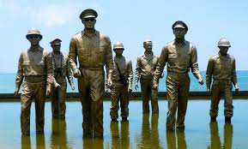
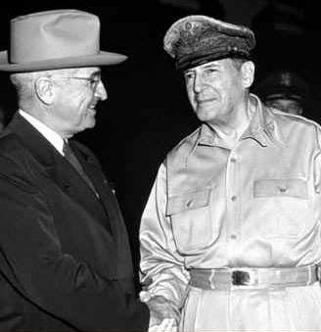
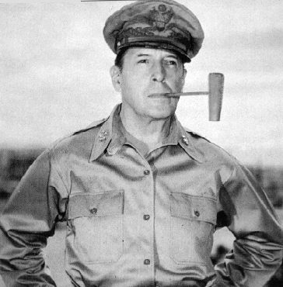
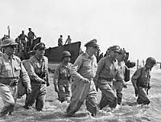

Slide 5
Korean Tug-of-War
By September the North Koreans had pushed to the southern-most tip of Korea
MacArthur counterattacked by attacking North Korea in two locations (Sept-Oct)
UN army pushed North Koreans close to China’s border.
Chinese felt threatened & joined North Korean forces.
China wanted North Korea as a “buffer” against South Korea
China & N. Korea pushed southward and captured Seoul (S. Korea’s capital)

Slide 6
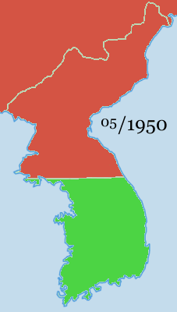
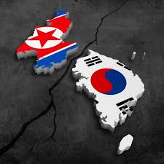
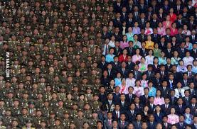

Slide 7
The Fighting Continues
General MacArthur wanted a nuclear strike on China.
Truman said no.
MacArthur asked congress without Truman’s ok.
Truman fired MacArthur
Fighting continues for 2 years.
UN troops take back Seoul and the rest of S. Korea.

Slide 8
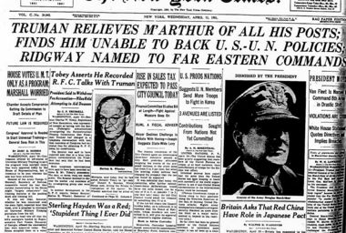

Slide 9
Outcome of the Korean War
Soviets initiate a cease-fire and truce talks began in July 1951
War ends July 1953
54,000 American lives lost
$67 billion spent
Korean border re-established at the 38th parallel
Democrats will forfeit the presidency in the 1952 election
Republican Dwight D. Eisenhower takes over

Slide 10
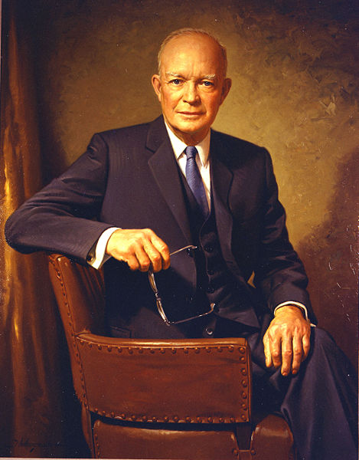

Slide 11
Outcome cont.
North Korea: Communist dictator Kim Il Sung.
Collective farms, military industry.
Develops nuclear weapons under Kim Jong Il.
Serious economic problems
South Korea: adopted democracy in 1987
Concentrated on industry and trade with help from U.S.
United States troops still in South Korea today.

Slide 12
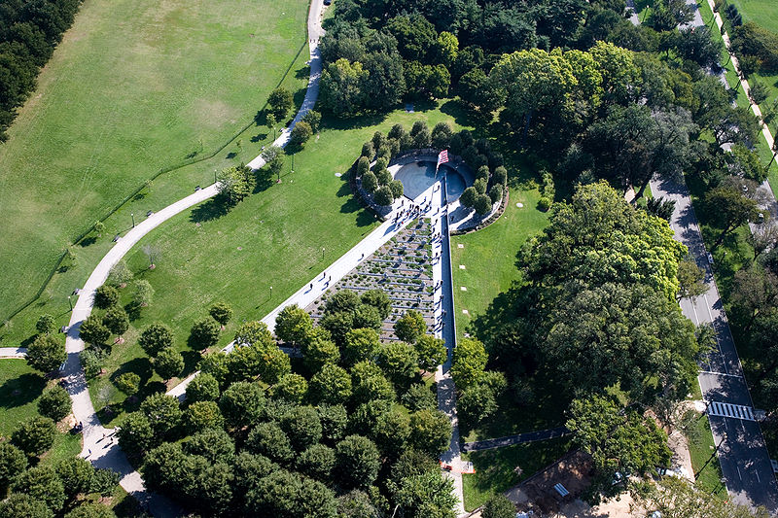
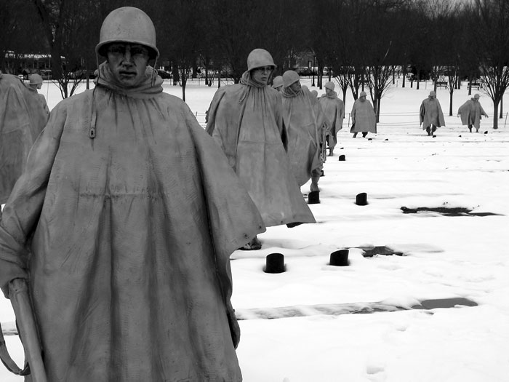
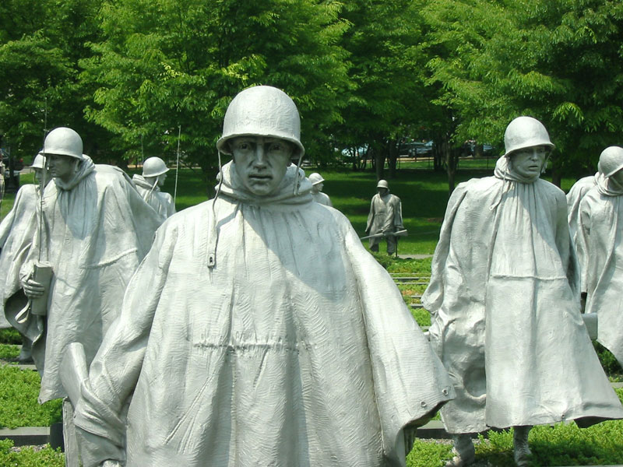
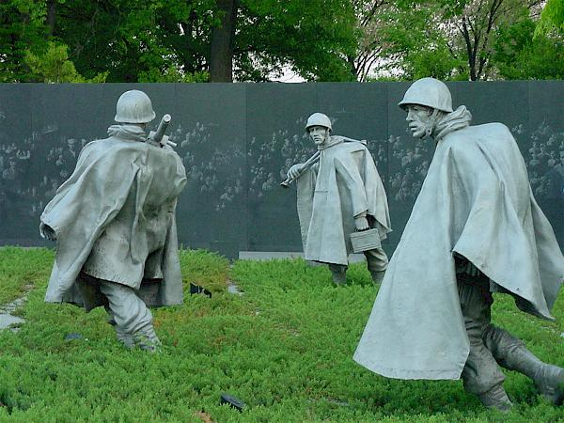
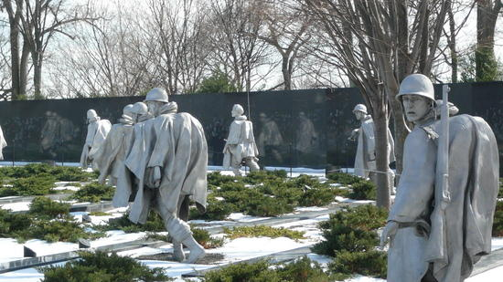
Notes:
In Washington D.C. 38 stainless steel 7ft statues. 38 soldiers represent 38th parallel.

Slide 13
