Slide 1
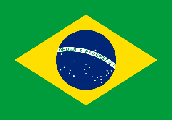
Brazil

Slide 2
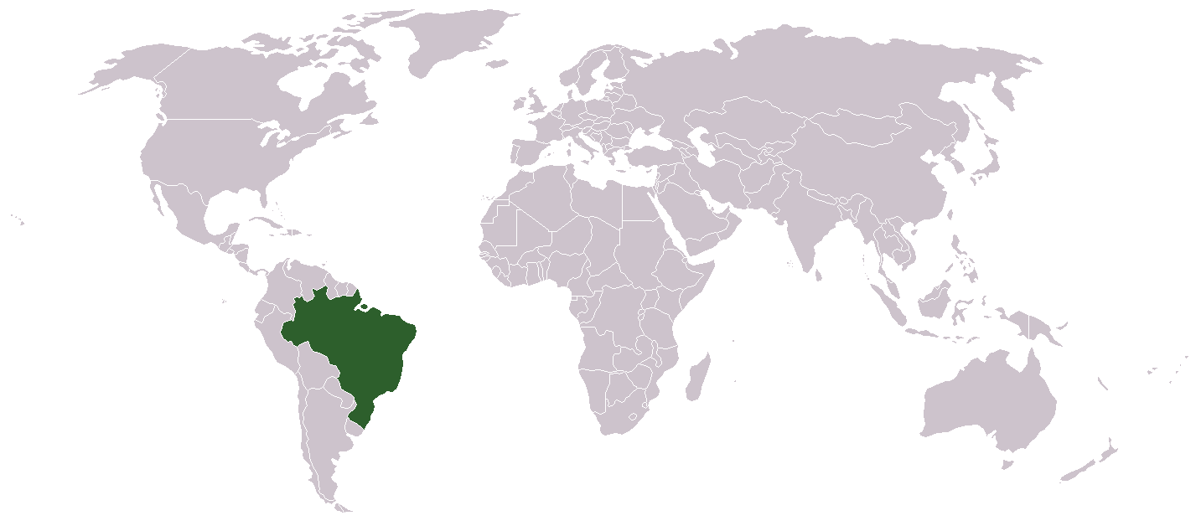

Slide 3
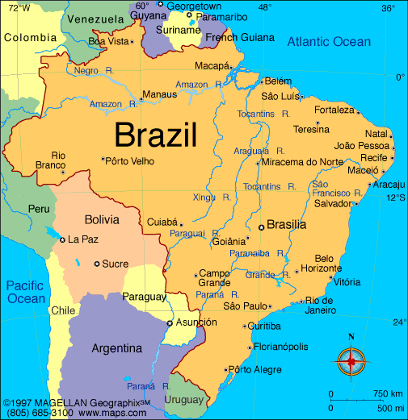

Slide 4
Climate/Terrain
Brazil is the largest country in Latin America
It is 5th largest in world in size and population
Wide range of Climates and varied topography, but mostly tropical
Home to the Amazon Rainforest with the largest biodiversity in the world

Slide 5
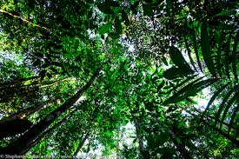
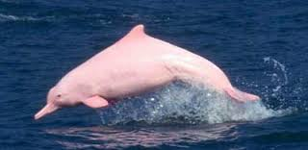
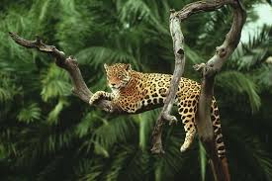
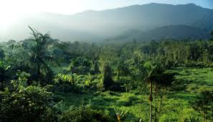
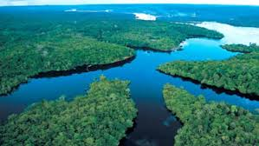

Slide 6
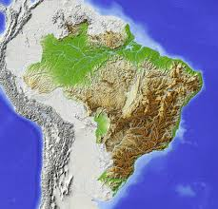

Slide 7
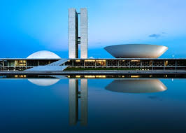
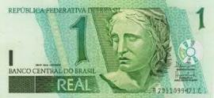
Government/Economy
Capital City: Brasília
Government: Federal Republic
Head of Government: President
Brazil has a mixed economy with
vast natural resources
World’s eighth largest economy
Mining, agriculture, manufacturing, coffee
Currency: The Real
1 real = 25¢ US

Slide 8
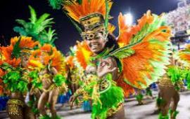
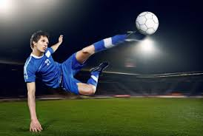
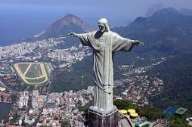
Demography / Culture
Population: 200.4 million
Religion: Roman Catholic
Literacy Rate: 91%
Life Expectancy: 71.6 (M), 78.8 (F)
Language: Portuguese
Sports: football (soccer)
Cultural: mix of black African slaves, Portuguese colonists, native peoples

Slide 9
Brief History
Portuguese explorer, Pedro Alvarez Cabral landed in Brazil in 1500.
The Portuguese cleared land for sugar. They imported massive amounts of African slaves when natives died of European diseases
Napoleon chased out Portuguese royal family out of Portugal and they fled to Brazil. They implemented change.
Pedro I declared Brazil independence in 1822.

Slide 10
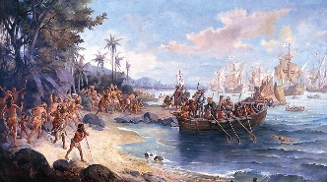
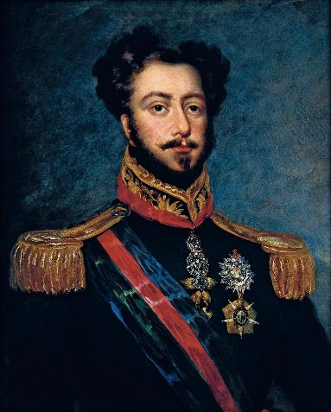
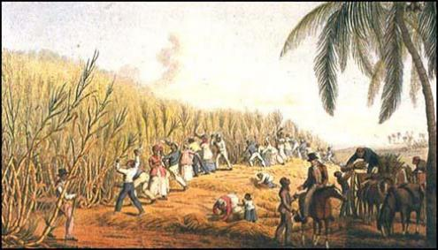

Slide 11
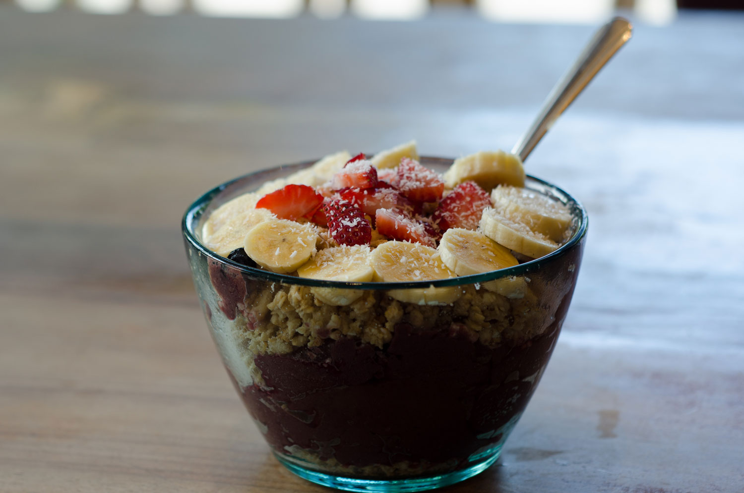
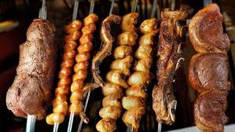
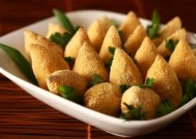
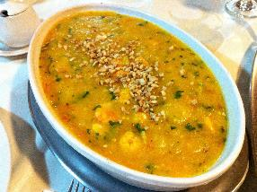
Food
Acai Bowl
Churrasquinho
Salgados
Bobó

Slide 12
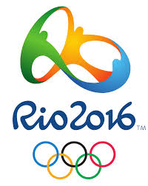
The Olympics

