Slide 1
Race and Ethnicity
Unit 3

Slide 2
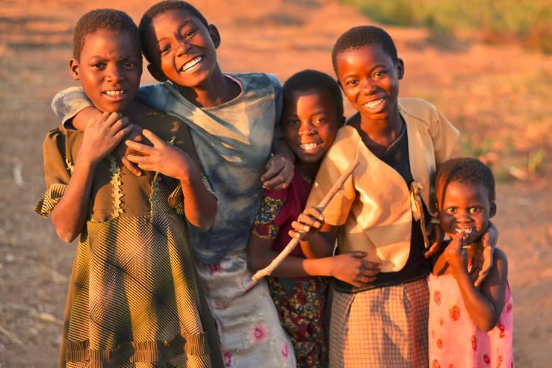
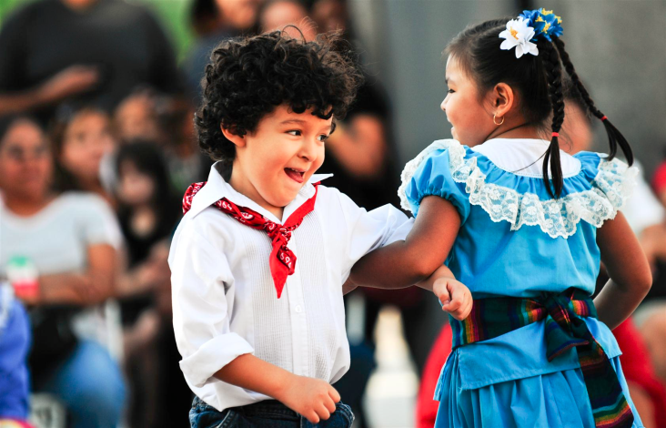
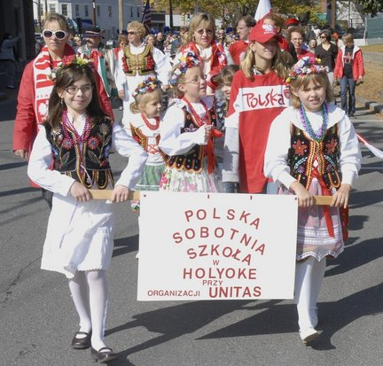
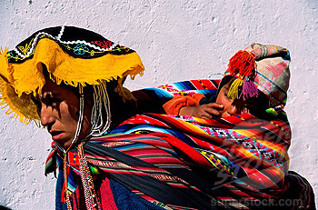
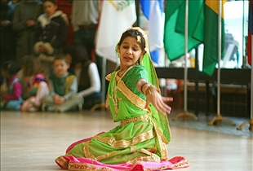
Ethnicity
Definition
Set of cultural characteristics that distinguish one group from another

Slide 3
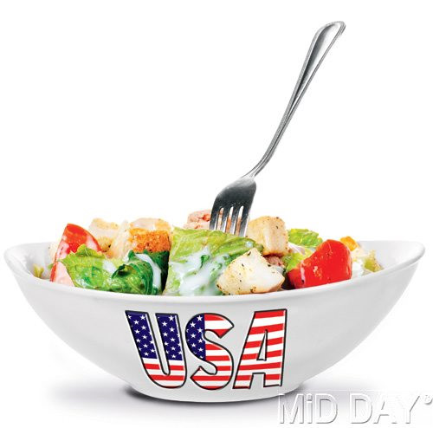
Melting Pot vs. Salad Bowl Theories

Slide 5
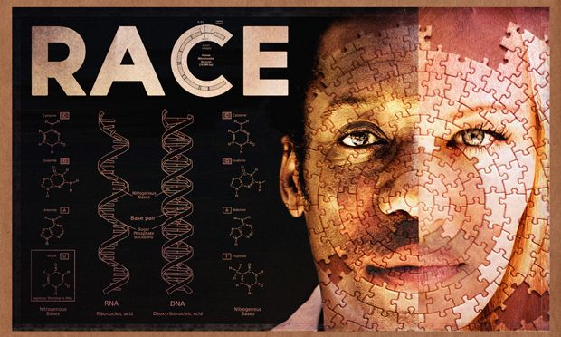
Race
Definition
A category of people who share inherited physical characteristics
For sociologists, race not useful as a biological classification but rather, how physical characteristics are perceived by others

Slide 6
Ethnic Self-Awareness
Personal Identity
1. A concept you develop about yourself that evolves over the course of your lifetime
Social Identity
1. A sense of self based on who you are in a group setting

Slide 7
Nationality
Definition- nation of birth or citizenship
Cultural and Ethnic Identity
Bi-cultural
Marginal
Assimilated
Separatist

Slide 8
Quick Write
What race do you identity with? (there can be more than one race)
What ethnicity do you identify with? (there can be more than one ethnicity)

