Slide 1
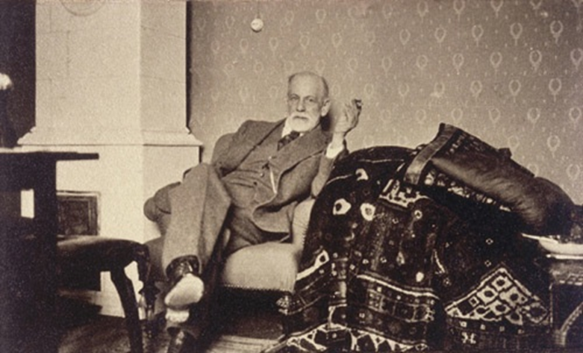
Psychoanalysts
Freud
Unit 5

Slide 2
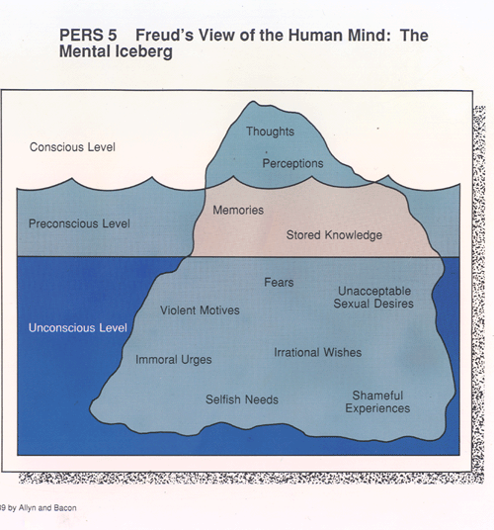
Sigmund Freud
Developed Psychoanalytic Model of Personality
Behavior driven by inner struggle of biological drives and societal rules
Conscious ideas occupy only small part of mind: deeper thoughts are out of awareness

Slide 3
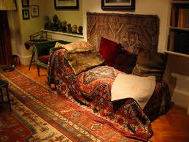
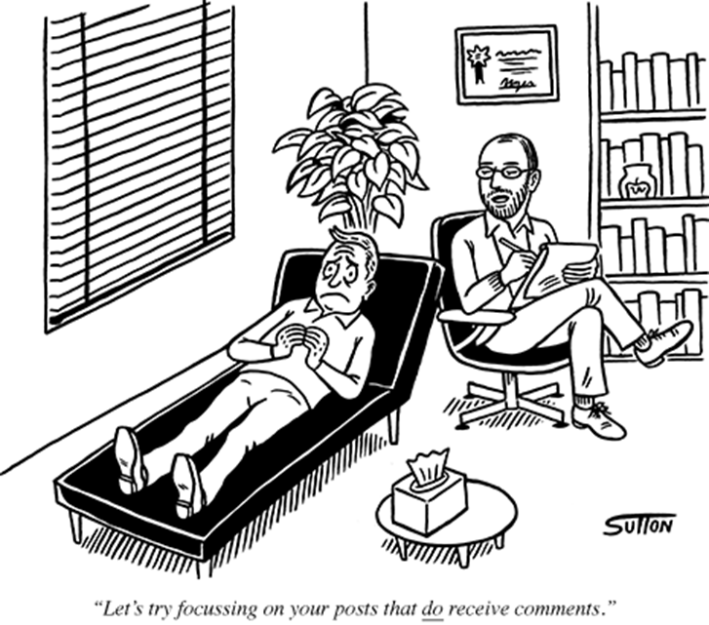
Freud…
B. Explored unconscious through psychoanalysis:
- Had patients to talk about thoughts in relaxed setting
C. Also used hypnosis and dream interpretation

Slide 4
Life Energy
A. Freud says people are born with instinctual energy that is changed and redirected during social development
Eros (Life Instinct) accounts for feelings and behavior related to self-preservation, preservation of species
Thanatos (Death Instinct) impels person toward aggression and destruction

Slide 5
The Levels of Consciousness
Conscious: Individual is aware of thoughts and feelings
Preconscious: Events that can be retrieved at will
Unconscious: thoughts, wishes, feelings, memories, urges about which we are unaware but may strongly influence behavior

Slide 6
Personality Structures
ID: unconscious
Demands immediate gratification of instinctual needs
B. Ego: Reason and good sense
Rational buffer between demands of id and external world
C. Superego: The moral system or conscience
Forces ego to consider reality and ideal standards

Slide 7
Table talk
Explain Freud’s Level of Consciousness theory.
Then draw a picture to describe the levels you mentioned.

Slide 8
The Psychosexual Stages of Development
Freud says personality develops through five stages based on sexual instinct
Different zones of body become sources of pleasure during different stages
Issues in adulthood may originate with conflicts during any one of these stages
Which may lead to fixation on certain traits

Slide 9
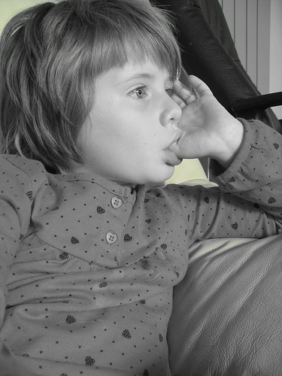
Stages of Development
Oral Stage (0-18 months)
Infant’s pleasure focuses on sucking, biting and chewing
Fixation later at this stage may be linked to excessive drinking, smoking, pencil chewing, fingernail biting, gum chewing, excessive eating

Slide 10
Stages of development
2. Anal Stage (18-36 months)
Pleasure derived from elimination of feces
Fixation may lead to anal expulsive (messy and disorganized) or anal retentive (highly controlled, compulsively neat) tendencies

Slide 11
Stages of development
3. Phallic Stage (3-6 years)
Children seek genital stimulation,& develop unconscious sexual desires
In Boys: Oedipus Complex
In Girls: Electra Crisis
Children deal with feelings by repression through identification process, which provides gender identity and strengthens superego

Slide 12
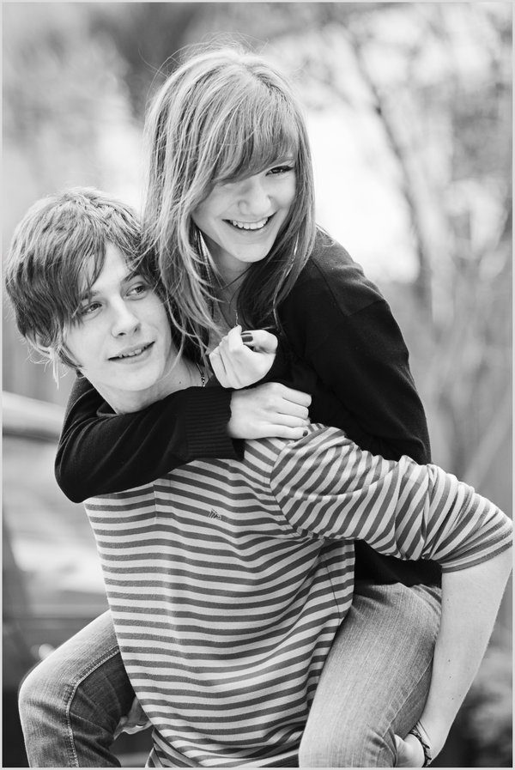
Stages of development
4. Latency Stage (6 years – puberty)
Lacking sexual content
The period of sexual repression in late childhood
5. Genital stage (puberty into adulthood)
Maturation of sexual interest
Most choose sexual intercourse for gratification

Slide 13
Table talk
Do you agree / disagree with Freud’s Stages of Development Theory?
Why?
Give examples
Is there a stage(s) in particular that you find odd / difficult to believe in?
Explain

Slide 14
Defense mechanisms
The Ego’s methods to resolve conflicts with the id and superego to guard against anxiety

Slide 15
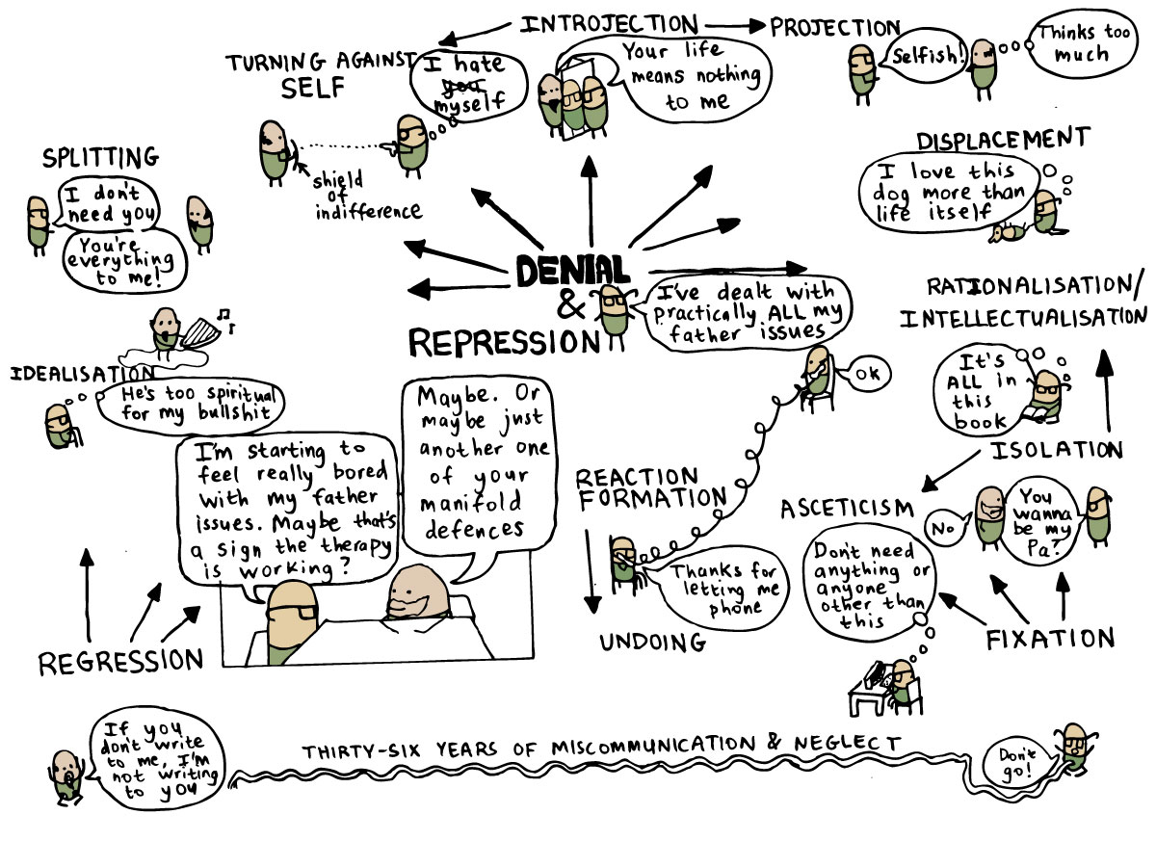

Slide 16
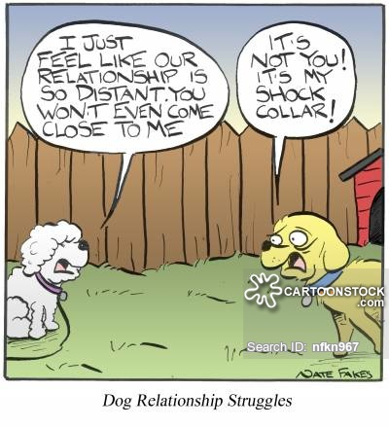
Defense mechanisms
1. Repression
Pushes anxiety-causing ideas into unconscious
May lead to outbursts of anger or development of other problems
2. Rationalization
Self-deception to justify unacceptable behavior
3. Displacement
Transfer of an idea or impulse from a threatening object to a less threatening object

Slide 17
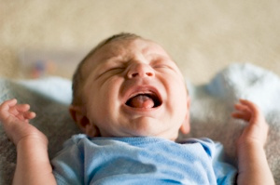
Defense mechanisms
4. Regression
Return to behavior that is characteristic of an earlier stage
5. Projection
Assigning unacceptable impulses outward to other people
6. Reaction Formation
Act the opposite of feelings to keep true feelings hidden

Slide 18
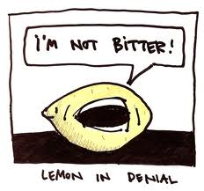
Defense Mechanisms
7. Denial
Refusal to accept reality of anything that is bad/upsetting
8. Sublimation
Channel negative impulses into socially acceptable behavior

Slide 19
Table Talk
Do you agree / disagree with Freud’s Defense Mechanism Theory?
Why?
Explain
What is your overall opinion of Freud?
Give evidence to support your claim

