Slide 1
Landmasses & Oceans
Unit 1

Slide 2
Continents
There are 7 continents on the Earth
North America
South America
Europe
Africa
Asia
Australia
Antarctica

Slide 3
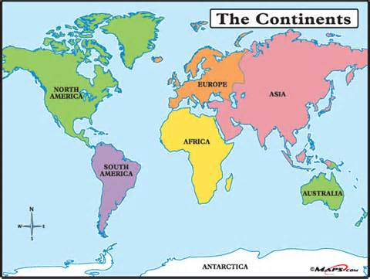

Slide 4
Oceans
There are 5 major oceans on Earth
Pacific
Atlantic
Arctic
Indian
Southern (Antarctic)

Slide 5
