Slide 1
Central Africa: Congo
Unit 4

Slide 2
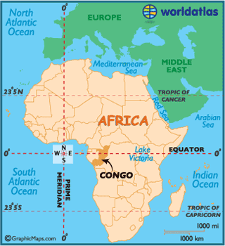
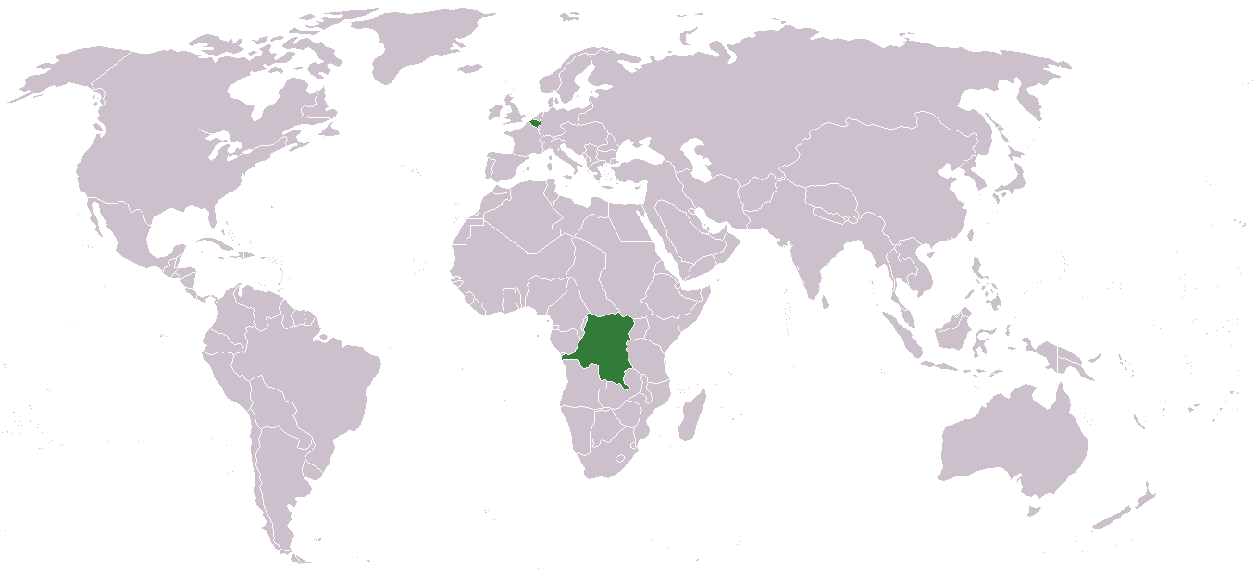

Slide 3
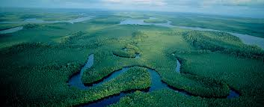
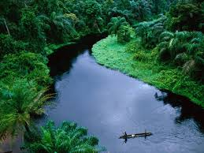
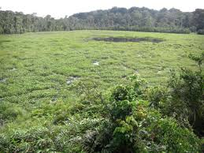
Climate / Terrain
Congo is the second largest country in the African continent.
Most of the inland area is tropical rain forest, drained by the tributaries (smaller rivers) of the Congo River
Congo lies on the Equator (0 degrees latitude)
Climate: hot and humid
The Congo River is the 2nd largest River
The Congo Rainforest is the 2nd largest

Slide 4
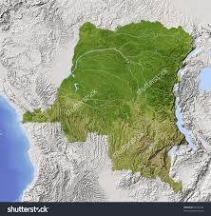
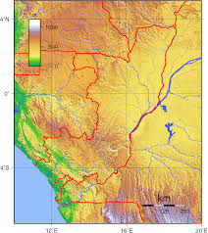

Slide 5
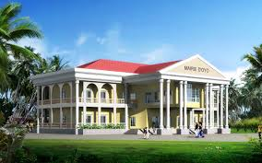
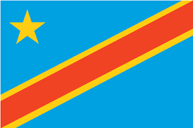
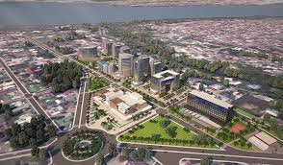
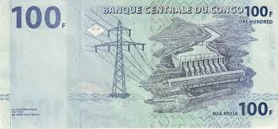
Government / Economy
Capital: Brazzaville
Government: Republic
Head of State: President
Head of Government: Prime Minster
Economy is based on agriculture, petroleum, and support services
Currency: Congolese franc
1 USD = 927.76 Congolese franc

Slide 6
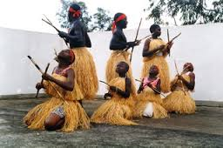
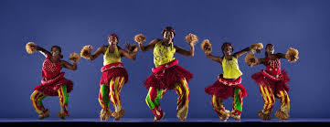
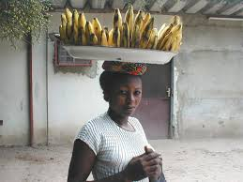
Demography / Culture
Population: 77,433,744
Life expectancy: 55 (M) 58 (F)
Religions: Roman Catholic (50%), Protestant (20%), Muslim (10%)
Languages: French
Literacy rate: 76.9 (M) & 57% (F)

Slide 7
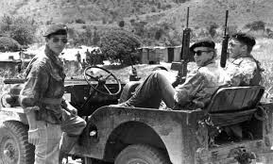
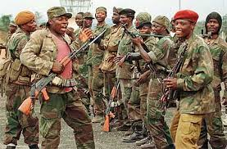
Brief History
Originally a Belgium colony
King Leopold II had extremely harsh rule
The French then controlled the Congo colony in 1880
Abuse of laborers led to public hatred against the French in the early 1900s
Congo proclaimed its independence in 1960, without leaving the French Community by calling itself the Republic of Congo

Slide 8
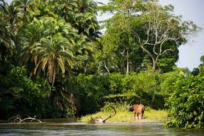
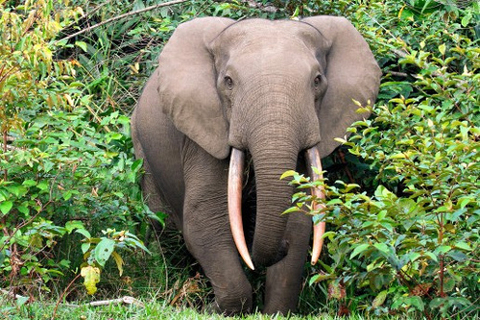
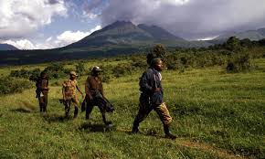
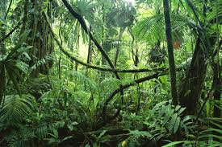
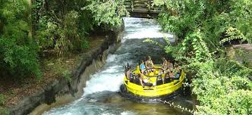
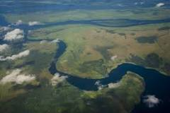
Tourism: Congo Rainforest

Slide 9
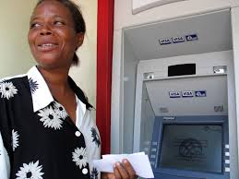
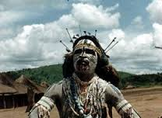
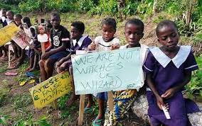
Interesting Facts
Taking pictures is ill advised. Locals get very upset, for they believe that “capturing a person’s image” removes his spirit.
Belief in witchcraft is so common that children are sometimes accused of being witches and most become homeless after families abandon them.
ATMs began appearing in the DRC in 2010 due to years of warfare.

Slide 10
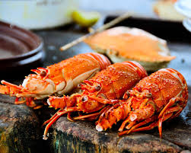
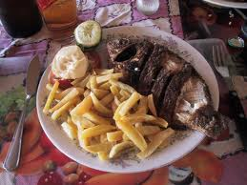
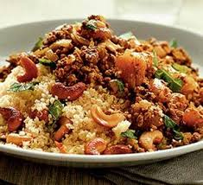
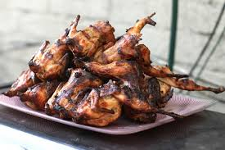
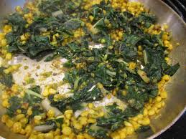
Food

