Slide 1
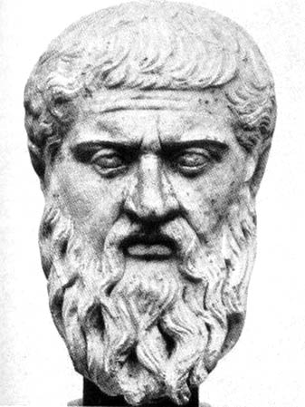
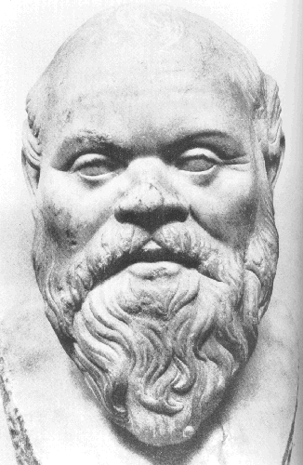
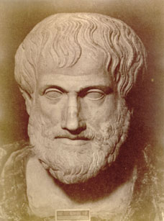
Important Greek Philosophers
Plato
Socrates
Aristotle

Slide 2
Importance of the Greek Philosophers
Greece was the birthplace of democracy
The Greek philosophers, mainly Socrates, Plato and Aristotle, helped to spread democracy by writing about it
People read their observations about democracy and society and applied it to other nations
Remember SPA- Socrates, Plato, Aristotle

Slide 3
Socrates
470-399 B.C.
His “Socratic method” (system of arguing or debate) was used as a foundation for Western logic and philosophy
Important influence on his students, including- Plato
Sentenced to death for his teachings, which often questioned authority.

Slide 4
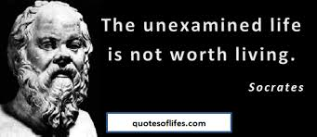
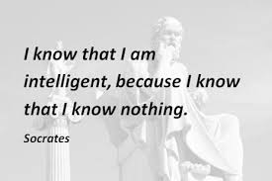
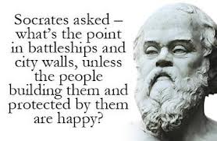

Slide 5
Plato
428-347 B.C.
Student of Socrates/teacher of Aristotle
Wrote The Republic, which outlines the ideal or perfect government
Rule of Law- no one is exempt from the law
Rule of Law was a safeguard against tyranny (corrupt rulers)

Slide 6
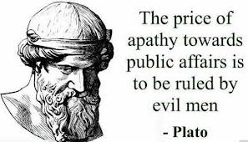

Slide 7
Aristotle
384- 322 B.C.
Student at Plato’s Academy
In his book, Politics, he examined human behavior in relation to government and society.
He focused on logic and science & the importance of evidence in reasoning.

Slide 8
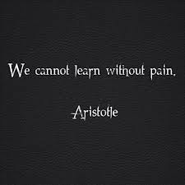
“Yes the truth is that men's ambition and their desire to make money are among the most frequent causes of deliberate acts of injustice.” ― Aristotle, Politics

