Slide 1
Indonesia
Unit 3

Slide 2
upiah

Slide 3
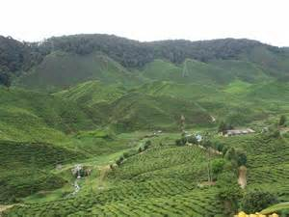
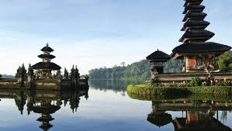
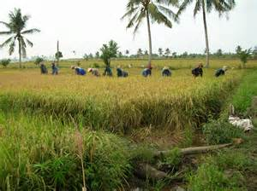
Climate / Terrain
Indonesia is the world’s largest archipelago with 13,677 islands
Consists mainly of coastal lowlands
Mountains are volcanic
Part of the “Ring of Fire”
Due to its location, natural disasters are common -Ex. Dec. 26, 2004- Tsunami
Climate: tropical with hot and humid weather in lower elevations and in higher elevations temperatures are more moderate

Slide 4
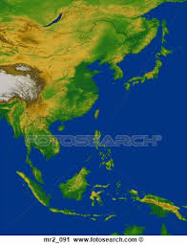

Slide 5
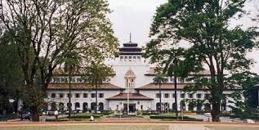
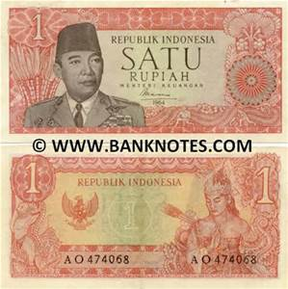
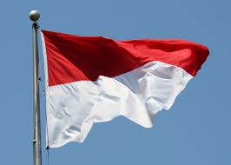
Government / Economy
Government: Republic
Head of State: President
Economy is centered on agriculture and industry
Main agricultural products are rice, peanuts, cocoa, coffee, palm oil
Currency: Indonesian Rupiah 1 USD = 13823.97 Rupiah

Slide 6
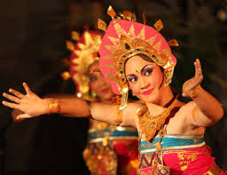
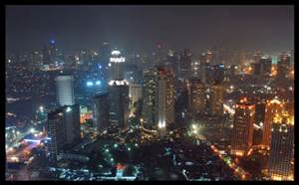
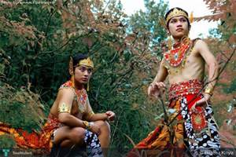
Demography / Culture
Capital: Jakarta
Population: 240,271,522
Life expectancy is 69.6 (M) & 74.8 (F)
Religions: Muslim (87 %), Christian (7 %), Roman Catholic (2.9 %)
Languages: Bahasa Indonesia, English, and Dutch
Over 300 ethnic groups and 583 languages
Literacy Rates: 95.6% (M) & 90.1 (F)

Slide 7
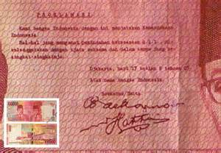
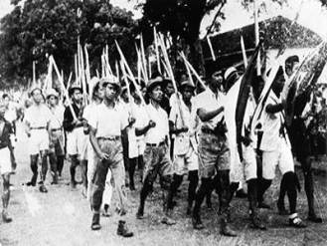
Brief History
In 1600s, the Dutch began their settlements in Indonesia and ruled for 300 years
In the early 20th century, Indonesia began a movement to fight for independence between WWI and WWII
During WWII, Japan occupied Indonesia
When Japan surrendered, a small group of Indonesians proclaimed independence

Slide 8
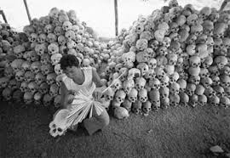
Brief History Continued…….
On Aug 17, 1945, the group established the Republic of Indonesia
Indonesia struggled to govern itself and there were several unsuccessful rebellions in 1958
The Indonesian mass killings of 1965–1966 (also known as the Indonesian genocide) were large-scale killings which occurred over many months targeting communist sympathizers & the Chinese.
More than one million people were killed

Slide 9
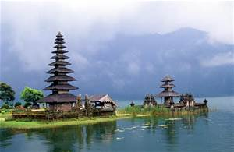
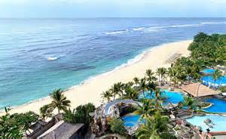
Tourism
Growing tourist hotspot because of its tropical landscape in places such as Bali

Slide 10
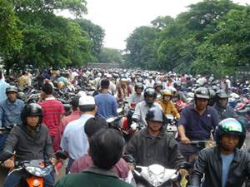
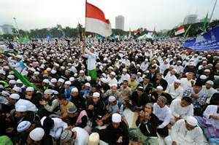
Interesting Facts
4th most populous country (China, India, U.S.)
World’s largest Muslim country
It takes over 12 hours of flying time to get from one end of the country to the other end
Of its 17,508 islands, only 6000 are inhabited by people
Exports 3000 tons of frog legs
to France each year

Slide 11
Food

