Slide 1
Decision Making
Choice, not chance determines destiny.
-Anonymous

Slide 2
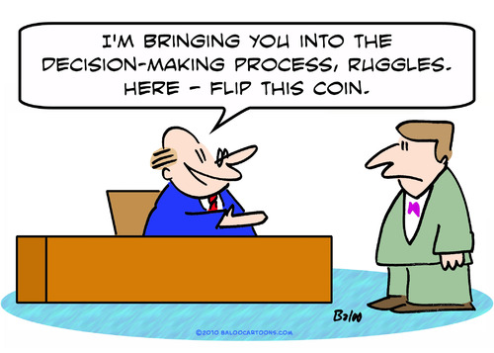
Decision Making Process
What to wear to school?
■ Decide what you want your image to be
■ Consider your choices (eliminate negative and narrow down to most positive)
■ Think about what other’s wear
■ Evaluate choices and consider which outfit most fits your goal.

Slide 3
Comprehensive Decision Making Model
□ Define your goal
□ State the decision to be made.
□ Analyze your resources.
□ Analyze your wants and needs.
□ Identify your choices.
□ Gather information
□ Evaluate your choices.
□ Make your decision

Slide 4
Long-term vs. Short-term Goals
Short term: essential to your happiness right now, immediate gratification
Long term: will be reached in the future, will not experience the rewards for years

