Slide 1
The United States
Unit 2

Slide 3
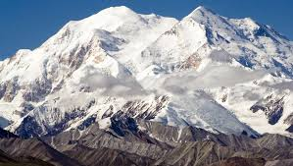
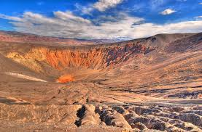
Geography: Climate/Terrain
3rd largest country in size and in terms of population
Lowest point in the U.S. is Death Valley, which is at -282 feet below sea level
Highest point: Denali (Mount McKinley) at 20,335 feet above sea level
Climate of U.S. varies, but it is considered mostly temperate climate -Tropical in Hawaii and Florida -Arctic in Alaska -Semiarid (semi-dry) in the plains west of the Mississippi river -Arid (lack of water/rainfall) in the Great Basin

Slide 4
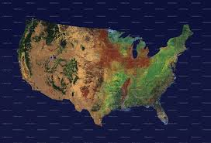

Slide 5
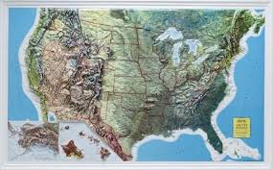

Slide 6
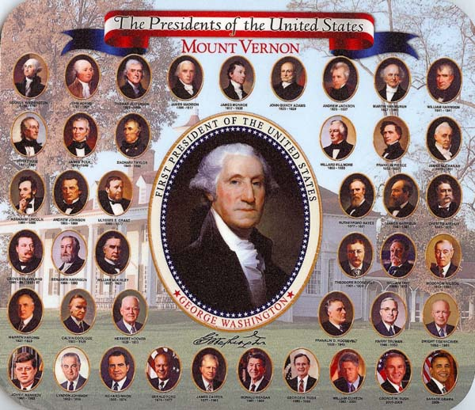
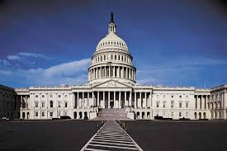
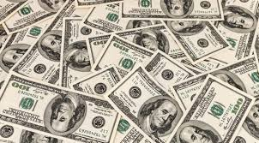
Government/Economy
Capital: Washington, D.C.
Government: Constitution-Based Federal Republic
Head of Government: President
2nd in command: Vice President
Assembly: Congress
House of Representatives & Senate
Currency: US Dollars
National Debt: $16.3 trillion (as of 2012)
Economic System: Capitalist

Slide 7
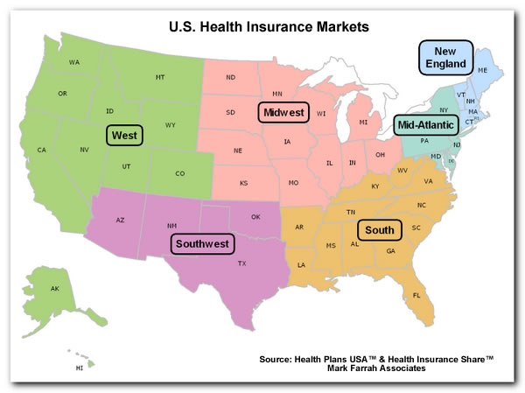
Demographic/Culture
Population: 318,892,103 (as of 2014)
Life Expectancy: 77 (Males) 81 (Females)
Literacy: 99 %
Languages: English (82%), Spanish (10.7 %), Asian and Pacific Islander (2.7%)
U.S. is divided into 6 regions known as: New England, the mid-Atlantic, the South, the Midwest, the Southwest, and the West

Slide 8
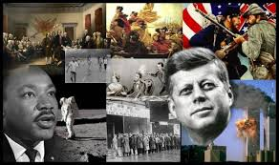
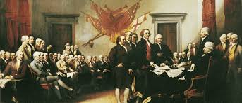
Brief History
Native people lived across the United States
17th century, settlers moved from Europe to the United States (New World)
Settlers fought for their independence from Britain in the late 18th century and formed a union of states based on a new constitution (American Rev)
Declared independence from Britain on July 4, 1776
20th century, fought along side with the allies in WWI & WWII

Slide 9
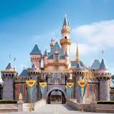
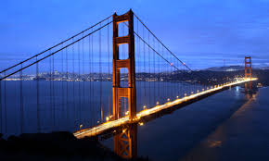
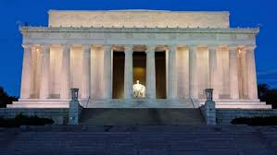
Tourism

Slide 10
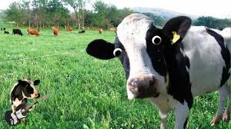
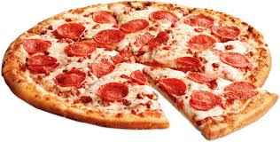
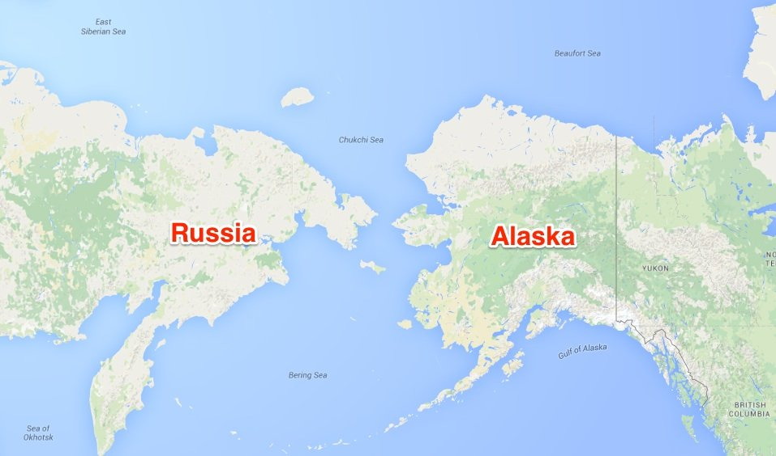
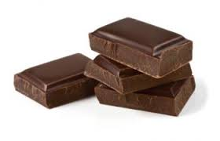
Interesting Facts
Montana has 3 times as many cows as it does people
We sell enough pizza every day to cover 100 acres.
Russia & America are less than 4 km apart at the nearest point.
The U.S. purchased Alaska from Russia for just US$7.2 million in 1867
Every second America consumes 100 pounds of chocolate
Every tweet Americans send is being archived by the Library of Congress.
There are more Facebook users than registered voters

Slide 11
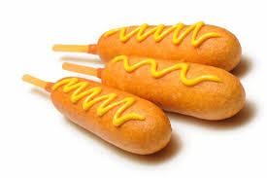
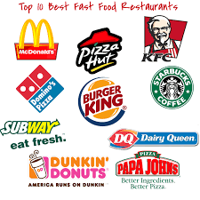
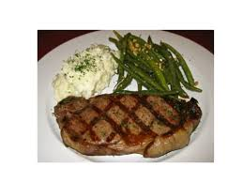
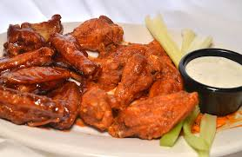
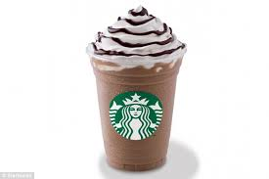
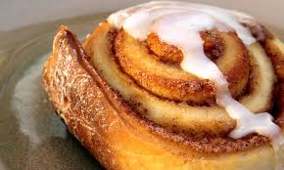
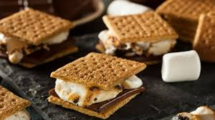
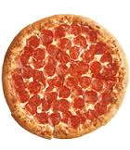
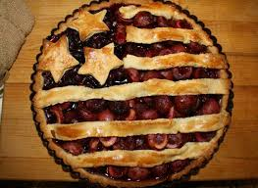
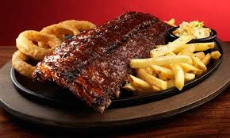
Food

