Slide 1
Russia & the Republics
Unit 3

Slide 2
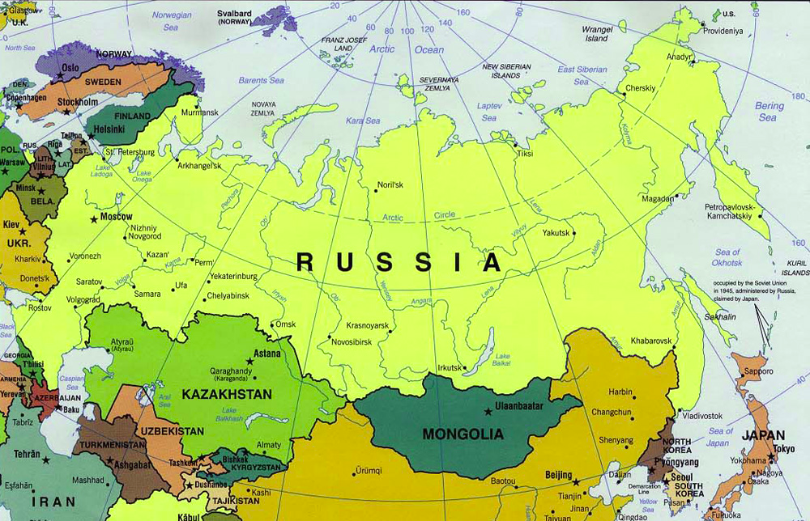

Slide 3
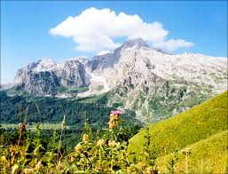
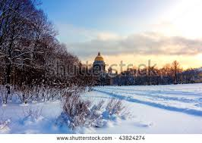
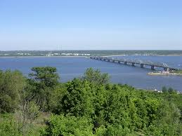
Climate / Terrain
Russia is the largest country in the world
Landscape varies from desert to frozen coastline
Russia is made up of rolling treeless plains called steppes
Russia has about 100,000 rivers
Major Mountain Ranges: Ural, Altay
Major Rivers: Amur, Irtysh, Lena, Ob, Volga,
Yenisey

Slide 4
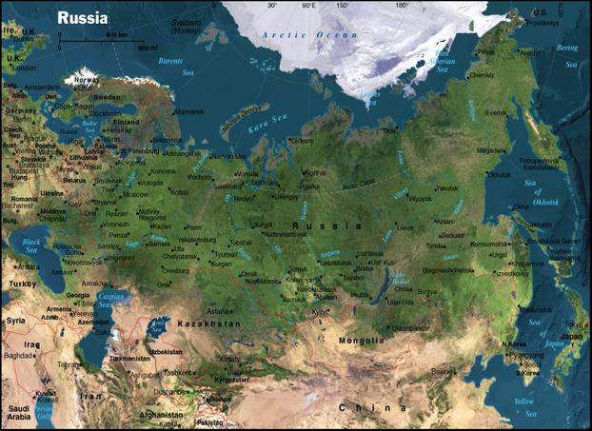

Slide 5
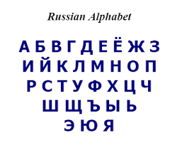
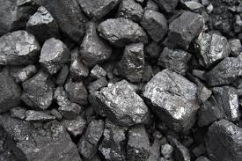
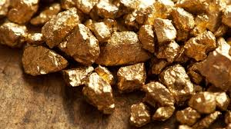
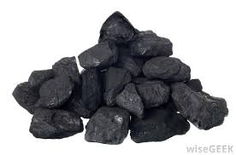
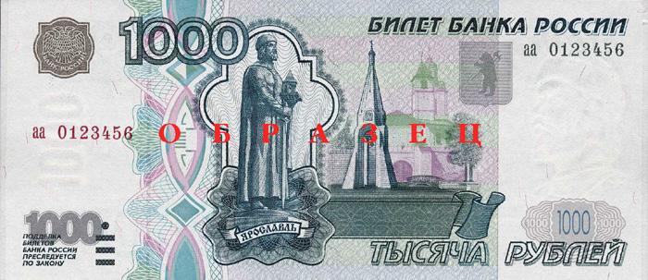
Government / Economy
Capital: Moscow
Government: Presidential Republic
Head of State: President
Head of Government: Prime Minister
They share executive power
Language: Russian
Economy is based on oil, coal, iron ore, gold, and aluminum
Money: Ruble
$1 U.S. = 61.76 Ruble

Slide 6
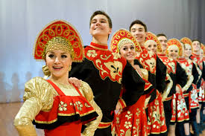
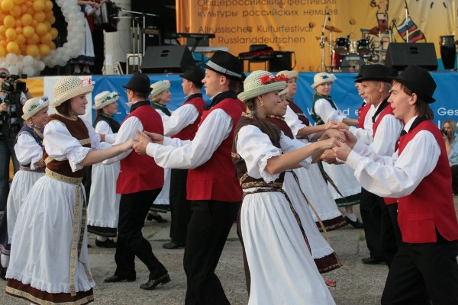
Demography / Culture
Population 142,470,272
There are 9 million more women than men
Life expectancy: men (65), female (76)
There are about 120 ethnic groups in
Russia who speak more than a hundred languages
80% of Russians trace their ancestry to
the Slavs, Tatars, and Ukrainians

Slide 7
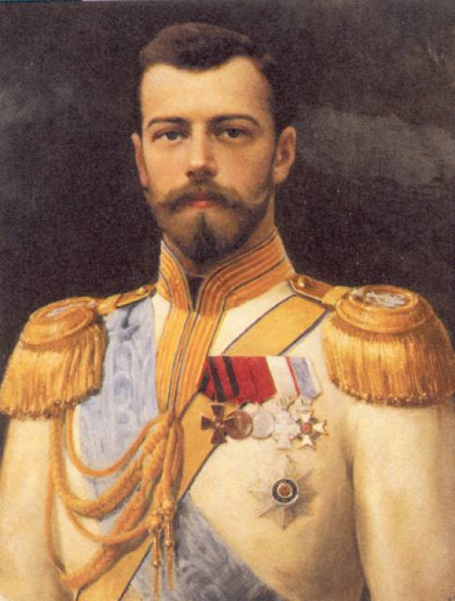
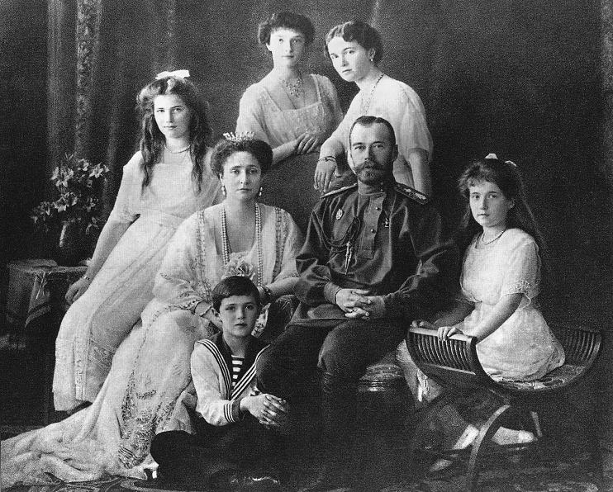
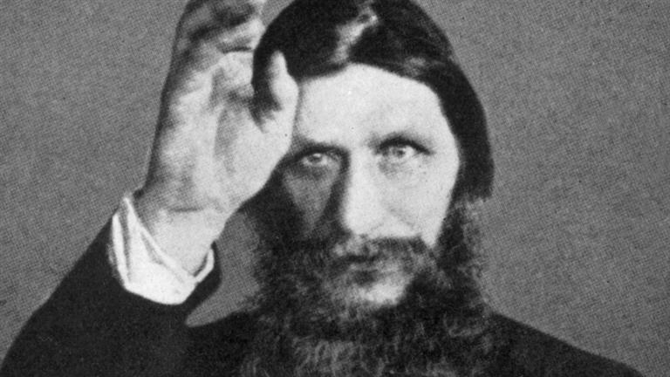
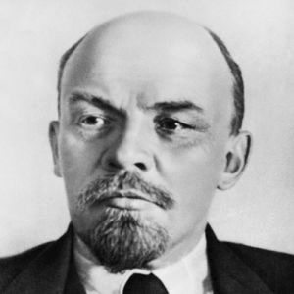
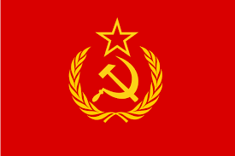
Brief History
In 1917, the Russians were unhappy with their government and overthrew the tsar (king) and formed an elected government
A few months after, a communist group called the Bolsheviks seized power USSR Flag
The Bolshevik leader Vladimir Lenin
took power and created the Union
of Soviet Socialist Republics (U.S.S.R.) along with 11 other countries

Slide 8
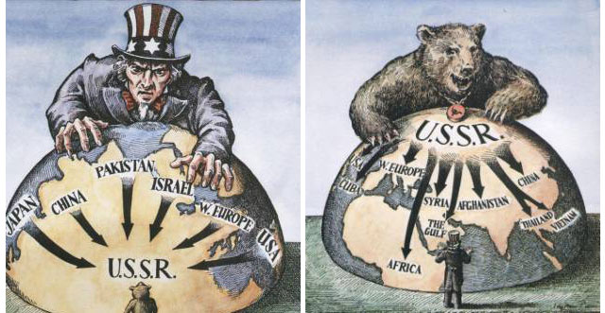
Brief History
U.S.S.R. fought on the side
of the U.S. in WWII
Tensions with the U.S.
led to the Cold War,
which ended in 1991
when the Soviet Union
was disbanded

Slide 9
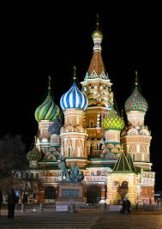
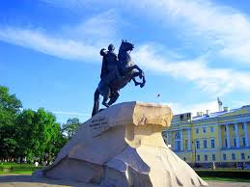
Tourism
Peter the Great Statue
Kremlin
Saint Basil’s Cathedral

Slide 10
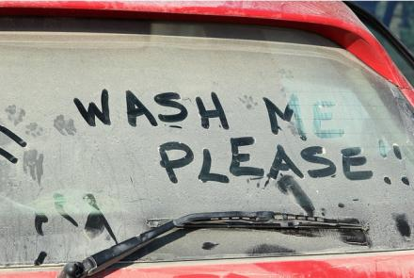
Interesting Facts
In 1908, the Russian Olympic team arrived in London 12 days late because they were not using the Gregorian calendar
The U.S. purchased Alaska from Russia for $7.2 million in 1887
There's a museum in Russia that hires cats to protect its artworks against rodents.
There was a "Beard Tax" in Russia, during Peter the Great's Reign, paid by anyone who had a beard.
It is a criminal offence to drive around in a dirty car in Russia.

Slide 11
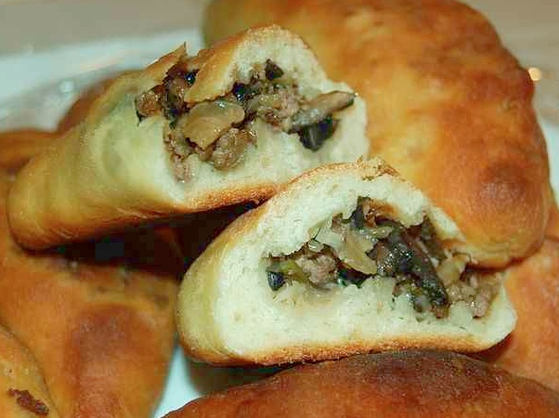
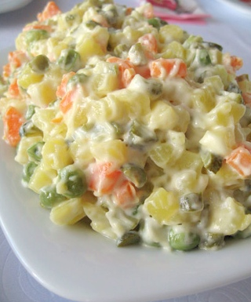
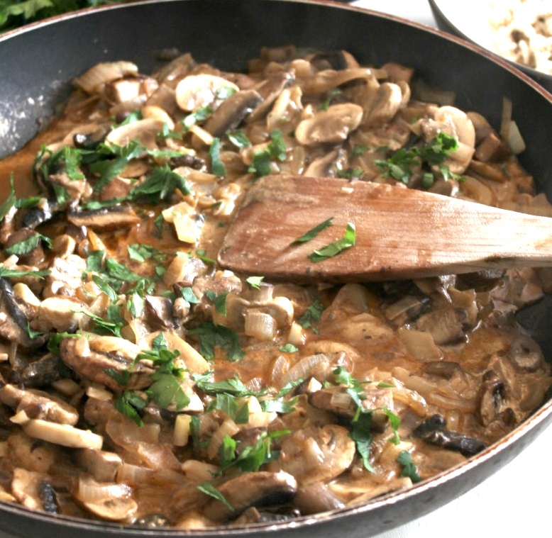
Food
Borsch
Mini-Pies
Russian Salad
Stroganoff

Slide 12
Plickers App Review Questions
Directions: Now I will be testing your knowledge of what we just learned. I will be passing out the plickers answer keys. The letter at the top of the page corresponds to an answer that can be chosen for a series of questions. Be sure to raise your answer key with the correct letter you’ve chosen at the top of the page. Then I will scan them using my phone to see who got it correct. Let’s begin. ☺

Slide 13
Question 1
What city is the capital of Russia?
A. Bern
B. Paris
C. Moscow
D. St Petersberg

Slide 14
Question 2
Which of the following is not part of the Russian economy?
A. Oil
B. Coal
C. Gold
D. Silver

Slide 15
Question 3
The currency in Russia is:
Euro
Pound
Dollar
Ruble

Slide 16
Question 4
There are more women than men who reside (live) in Russia.
True
False

Slide 17
Question 5
What was the name of the Bolshevik leader who created the USSR?
Rasputin
Tsar Alexander II
Vladimir Lenin
Joseph Stalin

Slide 18
Question 6
USA and the USSR fought together to bring about the end of the Cold War.
True
False

Slide 19
Question 7
The USSR and the USA fought against each other during the entire battle of WWII.
True
False

Slide 20
Question 8
Russia’s type of government is called a:
Presidential Republic
Constitutional Monarchy
Republic
Democracy

Slide 21
Question 9
Which of the following s not a major mountain range located in Russia?
Apennines
Ural
Altay

Slide 22
Question 10
Russia is the largest country in the world.
True
False

