Slide 1
Behavioral and Sociocultural theory
Watson
Skinner
Bandura
Unit 5

Slide 2
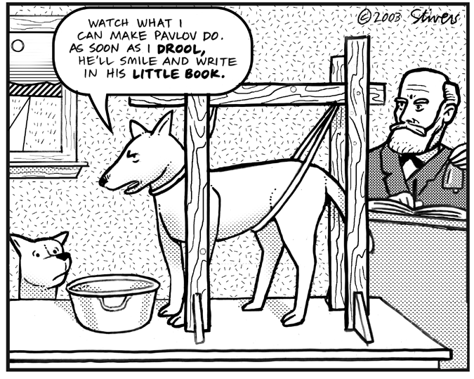
Classical Conditioning: Pavlov

Slide 3
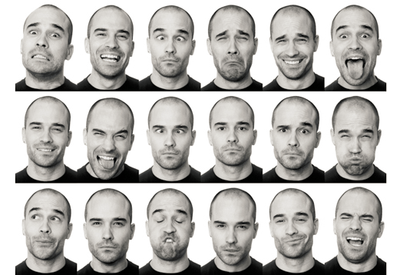
The Learning Theory
Personality is predictable based on individual history of reward and punishment
Based on external, rather than internal, influences

Slide 4
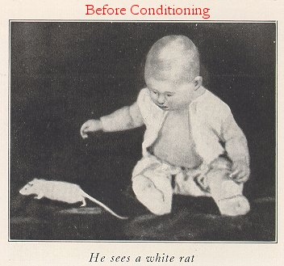
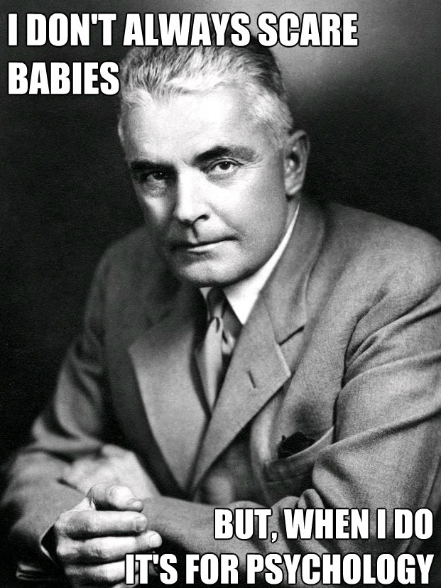
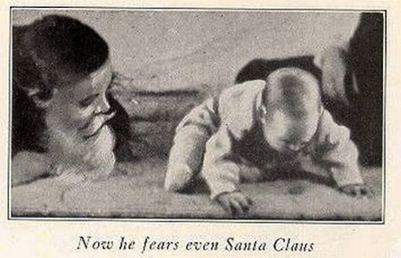

Slide 5
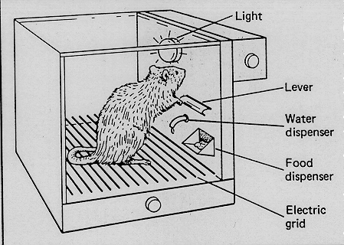
Learning Theory
C. B.F. Skinner: Operant behaviorism
Viewed personality in terms of observable behavior
Behavior under control of punishment and reinforcement: operant conditioning

Slide 6
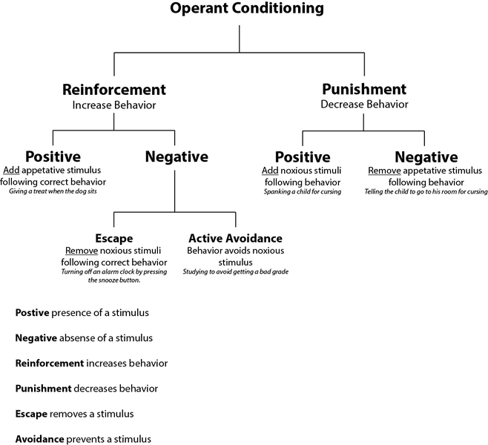

Slide 7
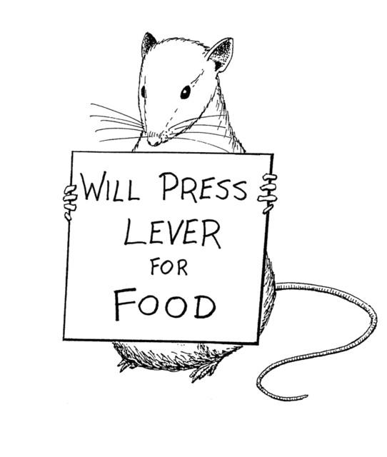
Learning Theory
3. Behavior therapy: attempt to change behavior through systematic alteration of undesired patterns of behavior to produce desired patterns

Slide 8
Learning Theory
4. Free Will vs. Determinism
Skinner rejects ideas of personal freedom, choice, etc.
Our decisions are based on environmental influences
Socialization: process by which people learn and adopt socially desirable behaviors and
Society shapes us to want what is good for society at a young age

Slide 9
Table Talk
Do you agree / disagree with B.F. Skinner and his Operant Behavior Theory?
Why?
Do you think that our behaviors can be altered through a systematic approach of change?
Why or why not?

Slide 10
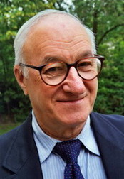
Social Learning Theory
Albert Bandura: Social Learning Theory
Personality is learned behavior in a social context
People can act intentionally to influence the environment
Internal variables influence how we act
Skills
Values
Goals
Expectations

Slide 11
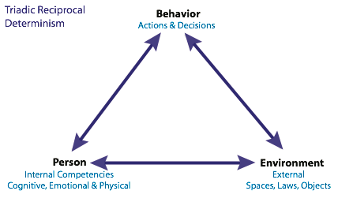
Albert Bandura
B. Bandura’s Key Concepts:
Reciprocal Determinism: overt behavior, cognition and environment influence one another

Slide 12
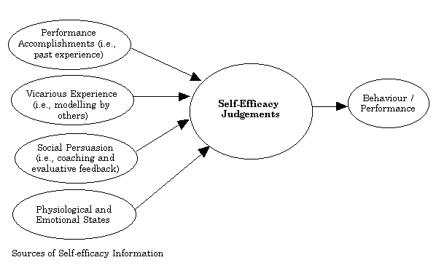
Albert Bandura…
2. Observational Learning: learning by watching others, including vicarious reinforcement and punishment
3. Self-efficacy: a learned expectation of success

Slide 13
Evaluation of Behaviorist Approach
Too simplistic to account for complex human personality
Rejection of internal psychological states = mechanical humans
Relies heavily on lab studies with lower animals

Slide 14
Table Talk
Do you agree / disagree with Albert Banduras Social Learning Theory?
Why?
Do you agree / disagree that we as humans learn by observation?
Why?

Slide 15
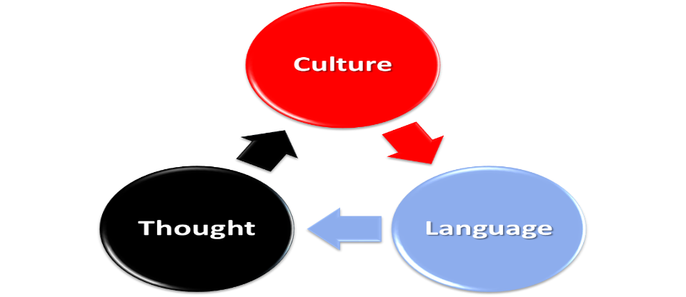
Sociocultural Theory
Focus on roles of ethnicity, gender, and culture on personality
Some Key Factors:
Affect self-concept and self-esteem of individual
Members of groups that hold power in society more likely to have positive sense of self
Example: Members of ethnic groups subject to discrimination have poorer self concepts

Slide 16
Sociocultural theory
Acculturation:
Process of adapting to new or different culture
Complete assimilation: abandon language and customs of origin
Maintain separation: retain original language/customs and never become comfortable with those of adopted country
Bicultural: successful integration of both sets of customs

Slide 17
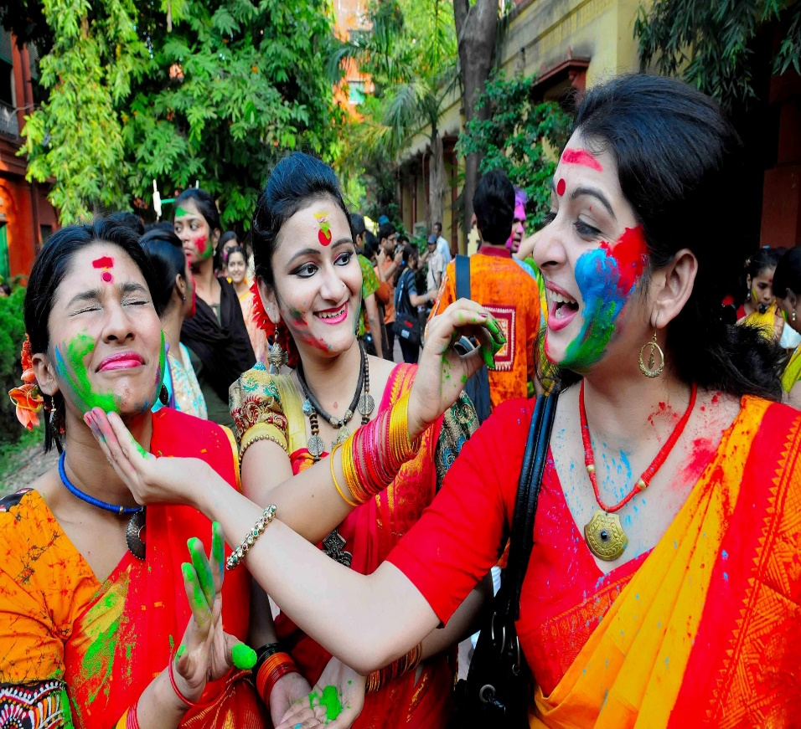
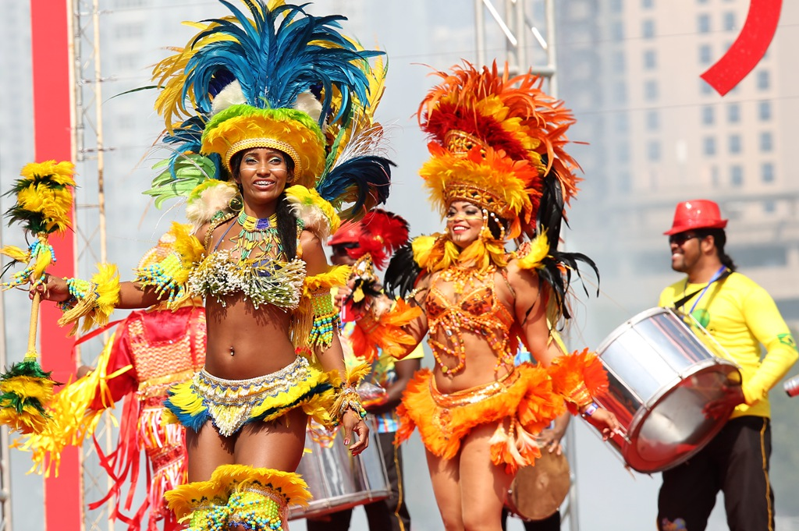
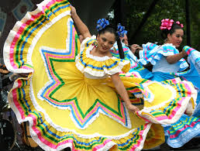

Slide 18
Collectivism vs. Individualism
Collectivism vs. Individualism
Individualists define themselves in terms of personal identities
Collectivists define themselves in terms of groups to which they belong

Slide 19
Table Talk
Do you consider yourself to be more of an individualist or a collectivist?
Why? Give examples.

